Slide 1

IBM Journey to Cloud and AI Analytics Modernization Workshop Featuring: Cloud Pak for Data 3.0.1
October 28, 2020
Presentation by:
Burt Vialpando and Kent Rubin - IBM
Notes:
IBM Journey to Cloud and AI : Analytics Modernization – Featuring Cloud Pak for Data
Instructors:
The goal of this IBM Workshop is to position Cloud Pak for Data to Line of Business professionals and those personas who would be using the platform.
Cloud Pak for Data paves the way to modernize application with insights from Data using Machine Leaning and Artificial Intelligence.

Slide 2
Welcome to the IBM® Briefing Center
Location logistics
Access restrictions
Restrooms
Emergency exits
Smoking policy
Breakfast / Lunch / Snacks
Special meal requirements
Introductions
IBM Speakers
IBM Proctors
IBM Sales Reps
Attendees (optional)
Notes:
Instructors:
Cover the logistic and introductions in a way that makes sense for the location where you are performing this workshop

Slide 3
IBM Analytics Modernization Workshop Agenda
Introduction Business Use Case | Lab 01 Lab 02
Collect: Connect Organize Collect: Virtualize | Lab 03 Lab 04 Lab 05
Analyze Deploy Infuse – OpenScale Infuse – Cognos Analytics Wrap up | Lab 06 Lab 07 Lab 08 Lab 09 Lab 10
Part 1
Part 2
Part 3
Notes:
Instructors:
Perform the lectures and labs in the three parts shown here.
Cloud Pak for Data is an integrated data platform that no one from the competition does as completely, covering the breadth and depth of this platform. This workshop will give attendees and students a good coverage of the capabilities and value of the entire platform.

Slide 4
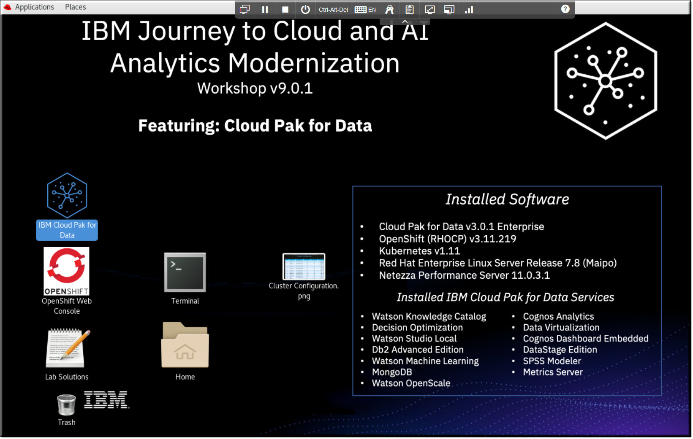
IBM Analytics Modernization Workshop The workshop Unified Desktop
Workshop lab exercise tips
Use full screen with a large screen computer
Use Chrome or Firefox browsers
Use [Ctrl][+] and [Ctrl][-] or [Ctrl][Mouse-Scroll-Wheel] to zoom
Use a mouse (keyboard alone is difficult)
Notes:
Instructors:
Before starting the labs, make sure your attendees are familiar with the workshop cluster desktop and have gone “full screen” to maximize the screen’s real estate.
Cluster architecture
Cloud Pak for Data is deployed on a multi-node OpenShift / Kubernetes cluster. Although you can deploy it in a 3-node cluster configuration (like we did for this workshop) it is strongly recommended that you deploy your production environment on a cluster with at least 6 nodes for better performance, better cluster stability, and increased ease of scaling the cluster to support workload growth.
In a 3-node cluster, each node acts as a master node, a management node, and a worker node. The higher the workload, the more likely problems are to occur. This can work OK in a demo environment like our workshop.
In a cluster with at least 6 nodes, there are three master nodes and three or more worker nodes. Using dedicated worker nodes means that resources are used only for application workloads, which improves the performance of the cluster.
It is also easier to expand a 6-node cluster, because each node has a specific role in the cluster. If you expand a 3-node cluster, the cluster has a mix of dedicated nodes and mixed-use nodes, which can cause some of the same issues that occur in a 3-node cluster. If you expand a 6-node cluster, each node has a dedicated purpose, which simplifies cluster management and workload management.

Slide 5
IBM Analytics Modernization Workshop
Introduction Business Use Case | Lab 01 Lab 02
Collect: Connect Organize Collect: Virtualize | Lab 03 Lab 04 Lab 05
Analyze Deploy Infuse – OpenScale Infuse – Cognos Analytics Wrap up | Lab 06 Lab 07 Lab 08 Lab 09 Lab 10
Part 1
Notes:
Instructors: Perform the first two lectures in this group together.
Grouping lectures and labs together will allow you to cover the materials in a more time efficient manner.
Encourage the students to continue doing more labs even if they finish the ones assigned. This allows the students who are quicker to cover more materials and perhaps be able to do the Deeper Dive labs in this workshop in one day.

Slide 6
Introduction Lab 01 – Getting Started
Notes:
6
TOPIC: INTRODUCTION – LAB: GETTING STARTED

Slide 7
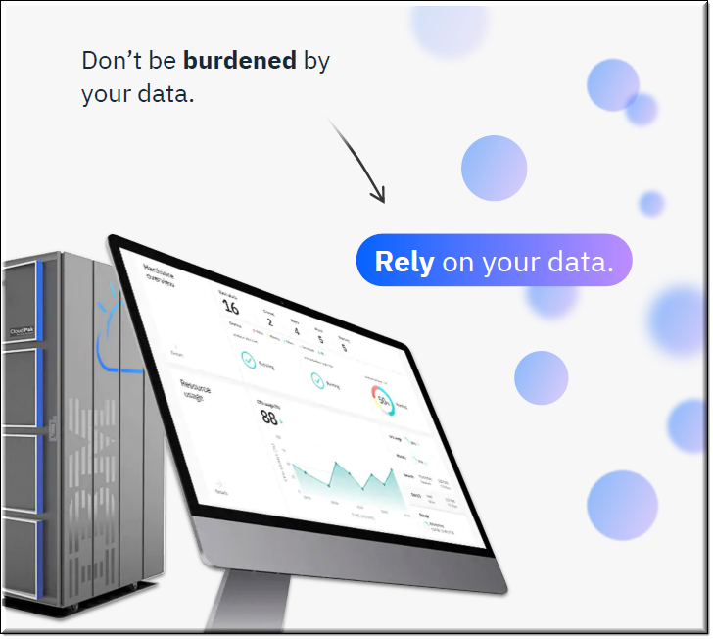
IBM Cloud Pak for Data
IBM Cloud Pak for Data is a single unified, integrated platform which helps to simplify the collection, organization and analysis of data.
With it, enterprises can turn data into insights through an integrated cloud-native architecture.
IBM Cloud Pak for Data is extensible and easily customized to unique client data and AI landscapes through an integrated catalog of IBM, open source, and third-party microservices.
Notes:
A cohesive modern data strategy is necessary to achieve modern AI and analytics results.
The IBM approach is based on three key take-aways:
data fuels digital transformation,
AI unlocks the value of data, and
hybrid cloud democratizes data.
These guide our overarching strategy for achieving real business value from data and AI.

Slide 8
Why Cloud Pak for Data? The business case
Enterprises are not leveraging the data that is created
2.5 quintillion bytes of data is created around the world EVERY DAY!
~70% of a company’s data remains unused, yet every company must be data driven in today’s ecosystem
Only 7.3% of leading company executives are confident in their own strategy for leveraging data
The
Challenge
Most enterprises are challenged to be truly data driven
Most large enterprises have legacy systems making it difficult to connect to and utilize all their data
Most industries have to deal with increasing regulatory constraints to protect their data
Highly paid teams spend 50-80% of their time to find, prepare, and govern data assets with increasing silos
97.2% of leading enterprise executives launch data and AI initiatives due to the knowledge that three-quarters of Fortune 1,000 companies have been replaced by data driven competitors
The
Factors
Cloud Pak for Data!
Comprehensive, integrated, and extensible platform to make data ready for AI
Built on enterprise grade private cloud that is reliable, efficient, scalable and portable
The right technology for the right job!
The
Solution

Slide 9
Cloud Pak for Data: built on cloud-native architecture
Multi-cloud is being driven by cloud-native architectures Microservices and containers are changing IT
The Compound Annual Growth Rate of traditional IT continues to shrink while public and private cloud continues to grow
Microservices and containers are keys to this transformation
CAGR *: -8%
Traditional IT
Lift and Shift
New App Development
Public Integration
Public with Virtual Private Cloud
Private Cloud
Public Cloud
Portable Applications
CAGR: 16%
CAGR: 30%
Notes:
Let’s step back to review why Cloud Pak for Data architecture is important.
Over the past few years, there has been a steady shift in how software is developed and consumed with increased adoption of public cloud. However, many enterprise customers are wary of fully embracing public cloud. Part of this is due to regulatory and compliance requirements, while part of it is cultural. Data gravity is also a factor given most of enterprise data currently resides on-premises and moving it to public cloud is not a viable option in the short term. Despite these concerns, customers are looking to modernize their workloads to prepare for a cloud future.
With the advent of private cloud, customers can now realize benefits of cloud behind their firewall. Companies are moving traditional on-premises workloads to private for increased agility and efficiency – both lift and shift, and afresh.
Cloud-native architectures and containers are driving multi-cloud adoption. In fact, more than 85% of companies are committing to multi-cloud.

Slide 10

Microservices – the first key to cloud native applications Making development & deployment more efficient
UI
UI
Microservice
Microservices benefits *
Improved fault isolation:
Larger applications can remain largely unaffected by the failure of a single module
Technological flexibility:
Try out a new technology stack on an individual service and roll it back if required
Easier development:
A new developer can more easily understand the functionality of a service
Optimized deployment:
Auto provision, auto scale and provide auto-redundancy
Business Logic
Data Access Layer
Microservice
Microservice
Microservice
Microservice
Microservice
DB
DB
DB
DB
Monolithic Architecture
Microservices Architecture
* This is not a claim that a microservice-based application approach is always better for every use case scenario
Notes:
Being Cloud Native means designing and running your applications to take advantage of all the benefits of a cloud system, including focusing on horizontal design – and treating the instances of your applications or services as “cattle” instead of using the traditional “pet” model.
The Cloud Native Computing Foundation describes cloud native applications as those that have the following three properties:
They are container packaged, running the application and processes as isolated units
They are dynamically managed by a central orchestrating process such as Kubernetes or Apache Mesos
They are microservices-oriented, having small, focused applications that are designed to be composable via service endpoints (such as REST)
This approach allows enterprises to ship faster, reduce risk, and increase efficiency by building smaller, autonomous (yet composable) services that can be started and stopped on-demand with little to no consequence.
Like SOA (or Service Oriented Architectures), Microservices are smaller services (Lego Blocks) within a larger architecture. In the case of having a shopping cart – you might have a cart service, a shipping service, and a payment service. Each service is really it’s own separate application – hosted on its own server (or in the cloud), abstracted by its own API, and operated independently of the other services. However, in contrast to SOA communication protocols used amongst microservices are more modern tailored to the needs of the cloud (e.g. REST, Thrift, HTTP and RPC vs SOAP).
Thus in a Cloud Native architecture, applications are COMPOSED of microservices reducing time to value and increasing reliability of the resulting application. However, microservices require a change in the way applications are being developed.
A critical point to make is that while CONTAINER services are excellent to host microservices they can equally well host a complete legacy stateful application (or Monolithic Applications), allowing customers to lift and shift traditional applications to the cloud in a step wise approach to application modernization.

Slide 11

Containers – the second key to cloud native applications Reducing operational and development costs
Virtual machines vs. containers *
App 1
App 2
App 3
Bins/Libs
LibsBins/
Bins/Libs
App 1
App 2
App 3
Guest OS
Guest OS
Guest OS
Bins/Libs
Bins/Libs
Bins/Libs
overhead
Container Engine
Hypervisor
Operating System
Infrastructure
Infrastructure
Containers can be 2 – 3 times more resource efficient than virtual machines
On average Docker developers ship software 7x more frequently
* Containers virtual software in the way that virtual machines have virtualized hardware
Notes:
Virtualization technologies are a solution to the problem of how to get software to run reliably when moved from one computing environment to another.
Though both VMware and Docker (as examples) can be categorized as virtualization technologies, optimal use cases for each can be quite different. For example, VMware emulates virtual hardware and must account for all the underlying system requirements – subsequently, virtual machine images are significantly larger than containers (up to 2 – 3X more resource intensive).
Docker does not create an entire virtual operating system – instead, all required components not already running on the host machine are packaged up inside the container with the application. Since the host kernel is shared amongst Docker containers, applications only ship with what they need to run – no more, no less. This makes Docker applications easier and more lightweight to deploy and faster to start up than virtual machines.
While VMWARE is inherently more secure as images are isolated from each other, IBM’s vulnerability advisor and security portfolio can make Docker containers as secure as VMWARE.
On average, Docker users ship software 7X more frequently. Can accelerate development and CI/CD pipelines by eliminating headaches of setting up environments and dealing with differences between environments.

Slide 12
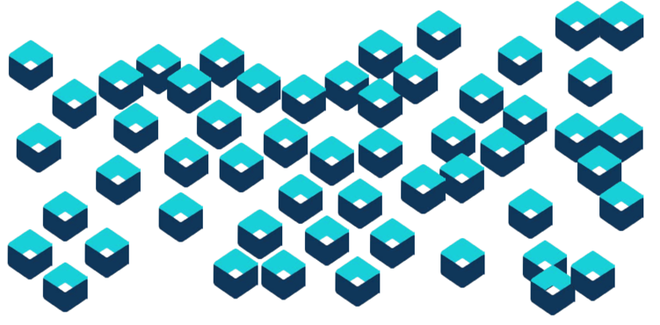
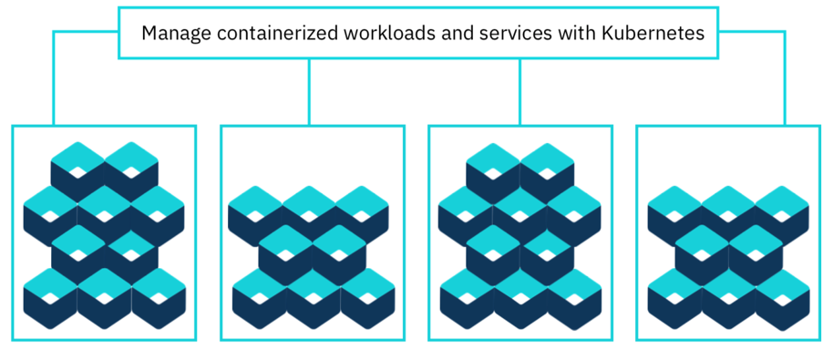
Container automation and orchestration is essential Enter: Kubernetes
Containers are revolutionizing IT
But they require orchestration
Kubernetes - κυβερνήτης Means “helmsman” or “pilot”
Notes:
Containers by themselves can out of hand, plus they don’t naturally lend to scaling, high availability and such. Therefore, an orchestrator is required.
Kubernetes has taken the lead in the industry over other offerings such as Docker Swarm and Apache Mesos.

Slide 13
Private Clouds address the new IT reality Created by digital transformation
Method | Development | Deployment | Environment
Waterfall | Monolithic | Bare metal | On-Premises
Agile Programming | N-Tier | Virtual Server | Off-Premises
Agile DevOps | Microservices | Containers | Cloud
Time to value
Perception of cost
Notes:
Customers are facing a new IT reality, driven by the need for digital transformation. The changes started as a slow evolution of the status quo in the late eighties and have dramatically accelerated in the past 10 years with the advent of mobile technologies and the cloud.
Methods: We have moved from Waterfall (80’s), to Agile programming (2000) to Agile DevOps (2010+)
Application Architecture and Development: from Monolithic Applications, to Client Server, to SOA and the Evolution of SOA represented by Microservices
Deployment: from Bare metal, to VMWARE Virtualization (allowing you to pack Applications, Middleware and OS and transport to different compute infrastructures) to Docker Containers (a lean and much more economical virtualization offering)
Hosting Environment: from On Premise, to Off Premise, to the Cloud (either on site or off site)
All these changes have been in an effort to speed up time to value, and innovate to survive the digital disruption while lowering costs.
Containerization transforms the data center from being machine-oriented to being application-oriented. Building management APIs around containers rather than machines shifts the “primary key” of the data center from machine to application. Containers encapsulate the application environment, abstracting away many details of machines and operating systems from the application developer and the deployment infrastructure. The decoupling of image and OS makes it possible to provide the same deployment environment in both development and production, which, in turn, improves deployment reliability and speeds up development by reducing inconsistencies and friction.
How OpenShift helps accelerate IT’s transformation efforts:
Cost effective Infrastructure – at its core is a container, Kubernetes based platform that brings all the benefits of such a containerized environment i.e., 2 – 3 times reduction of the amount of resources needed vs VMWARE or Bare Metal when running typical Enterprise workloads.
Accelerate Time to Market - OpenShift is the perfect environment for BOTH Cloud Native (Microservices based) applications as well as to Lift and Shift and modernize existing monolithic applications . ICP comes with a very broad catalogue of Services that are from both OS (e.g. MONGO, POSTGRES, REDIS, MYSQL, RABBITMQ etc.) and IBM (WAS Liberty, MQS, DB2 as well as AI Services such as WATSON Compare & Comply etc.) thus, providing Developers choice and the ability to innovate composing applications from tested and proven components. The DEVOPS experience is that of extreme speed and agility (e.g. 5 Sec to deploy an MQS Containerized service in Production) .
Manage – Using Kubernetes and state of the art services such as Terraform (IBM CAM for Multi-Cloud Management), HELM (Open Source Kubernetes Package Manager), PROMETHEUS (OS Based Monitoring Engine) , GRAFANA (OS Based, Dashboarding engine) and other OS and IBM Services for HA/DR, Integrated Access Management, Key encryption etc. results into a platform that offers very high degrees of Automation while at the same time being extremely scalable and able to run on top of multiple cloud Infrastructures (both On and Off Premises).
Open community-based platforms (e.g., Kubernetes, Cloud Foundry, Open Whisk, etc.) for choice of cloud providers and flexibility in deploying on and off-premises, develop ONCE – deploy anywhere (e.g. SL, AWS, AZURE , GOOGLE). No vendor lock-in. Provides the ultimate approach to cloud flexibility – giving enterprises a seamless choice between private and public environments for the best of both worlds.

Slide 14
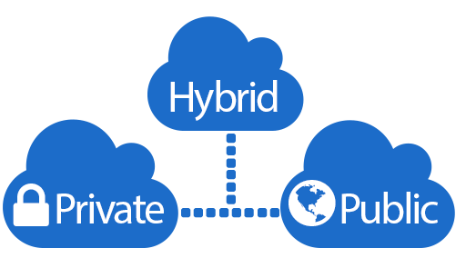
Public Cloud + Private Cloud = Hybrid Cloud * Different cloud options
 | Public Cloud | On-Premises Private Cloud | Hosted Private Cloud | Hybrid Cloud
Hardware Deployment and Management | Vendor | Customer | Vendor | Shared between vendor and customer
Hardware Sharing Model | Shared | Dedicated | Dedicated | Partially shared and partially dedicated
Scalability | High | Medium | High | High
Low Cost | Yes | Sometimes | Sometimes | Sometimes
Predictable Cost | No | Yes | Yes | No
Utility Billing | Yes | No | Depends on vendor | Partial
Flexibility | Yes | Limited | Limited | Yes
Customization Capabilities | No | Yes | Depends on vendor | Partial
Enhanced Security and Compliance | No | Yes | Yes | Yes
Instant Provisioning | Yes | Yes | Yes | Yes
* A “Hybrid Cloud” is a highly orchestrated environment, where all sources act as one
A “Multi-cloud” environment simply refers to the use of multiple cloud sources of any kind, without necessarily being orchestrated
Notes:
Often called “the best of both worlds,” hybrid clouds combine on-premises infrastructure (private clouds), with public clouds so organizations can leverage the advantages of both. In a hybrid cloud, data and applications can move between private and public clouds for greater agility, flexibility, and economics.

Slide 15


Why care about Private Clouds? Adoption brings agility and efficiency
Cost Efficient & Scalable Infrastructure
50% Benefit
Data Center System Utilization & Server Reduction
Build, package & deploy applications in containers; run at scale with Kubernetes
75% Benefit
Manage Performance Elasticity, Bursting, High Availability
35% Benefit
DevOps Faster Deployments
Accelerate Time to Market
30% Benefit
Deployment Efficiency Containers & Microservices
Refactor applications into microservices & modernize monolithic applications
50% Benefit
Improved Security Management & Risk Reduction
Manage Data at Scale
3-Year $5.4 Million Cost Savings; 255% ROI
Business Value Assessment Customer Output: Standard On-Premises vs OpenShift
Access, govern, & analyze your data at scale; accelerate your journey to AI
Notes:
Why are companies adopting private cloud? Adoption is being driven by the need for agility and increased efficiency (better economics).

Slide 16
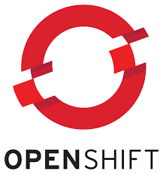
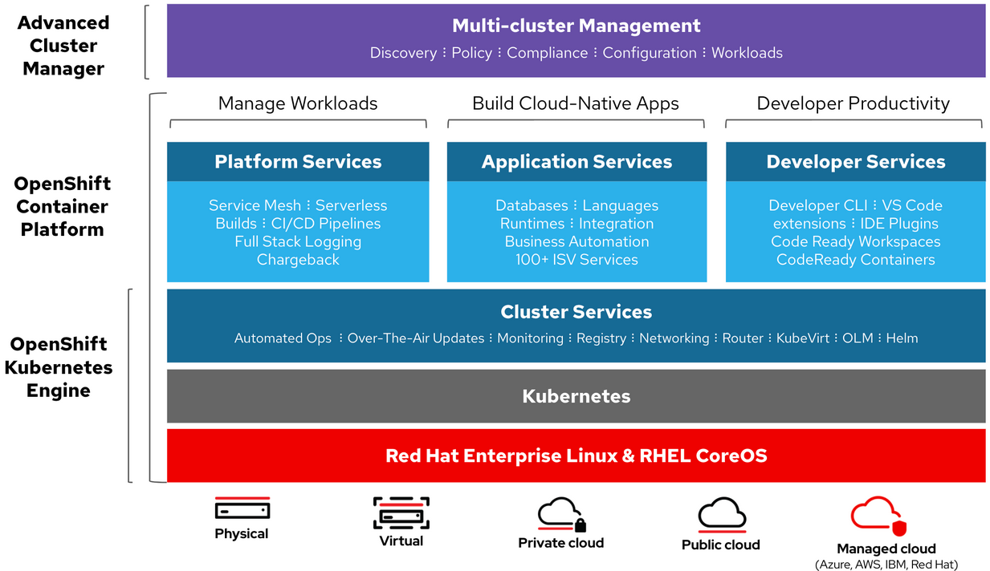
The Private Cloud Platform Market Leader Red Hat OpenShift Kubernetes Engine
Notes:
Red Hat® OpenShift® is a container platform for Kubernetes that can automate the provisioning, management and scaling of applications so that you can focus on writing the code for your next big idea.
Container host and runtime - Red Hat OpenShift ships with Red Hat® Enterprise Linux® CoreOS for the Kubernetes master, and supports Red Hat Enterprise Linux for worker nodes. Red Hat OpenShift supports standard Docker and CRI-O runtimes.
Enterprise Kubernetes - Red Hat OpenShift includes hundreds of fixes to defect, security, and performance issues for upstream Kubernetes in every release. It is tested with dozens of technologies and is a robust tightly-integrated platform supported over a 9-year lifecycle.
Validated integrations - Red Hat OpenShift includes software-defined networking and validates additional common networking solutions. Red Hat OpenShift also validates numerous storage and third-party plug-ins for every release.
Integrated container registry - Red Hat OpenShift ships with an integrated, private container registry (installed as part of the Kubernetes cluster or as standalone for greater flexibility).
Developer workflows - Red Hat OpenShift includes streamlined workflows to help teams get to production faster, including built-in Jenkins pipelines and our source-to-image technology to go straight from application code to container. It is also extensible to new frameworks like Istio and Knative.
Easy access to services - Red Hat OpenShift helps administrators and support application teams, with service brokers (including direct access to AWS services), validated third-party solutions, and Kubernetes operators through the embedded OperatorHub.

Slide 17
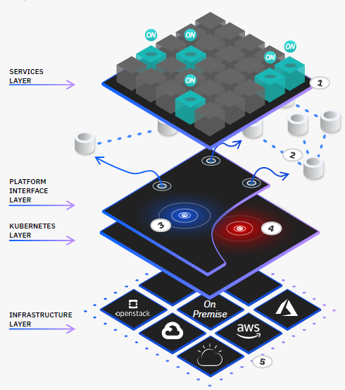

Cloud Pak for Data (CPD) Architectural overview
1. Services Ecosystem
At a click, access and deploy an ecosystem of 45+ services and templates from IBM and third parties.
2. Data Virtualization
Query across multiple data sources fast and easy without moving your data.
3. Control Plane (Platform Interface)
Speed time to value with a single platform that integrates data management, data governance and analysis for greater efficiency and improved use of resources
4. OpenShift (Kubernetes Engine)
Leverage the leading hybrid cloud, enterprise container platform for an innovative and fast deployment strategy.
5. Any Cloud (Infrastructure)
Avoid lock-in and leverage all cloud infrastructure with our “Any Cloud” mentality.
Notes:
Designed with cloud in mind
Many companies are embracing cloud-concepts because they need reliable, scalable applications. Additionally, companies need to modernize their data workloads to use hardware effectively and efficiently. IBM Cloud Pak for Data is composed of pre-configured microservices that run on a multi-node OpenShift cluster, which enables it to manage resources elastically and to run with minimal downtime.
By bringing together data governance and analytics services, Cloud Pak for Data enables you to reduce the cost and burden of maintaining multiple applications on disparate hardware. It also enables you to assign resources to workloads when you need to and reclaim those resources when you don't.
With a single, managed platform, it's easier for your enterprise to adopt modern DevOps practices while simplifying your IT operations and reducing time to value.

Slide 18





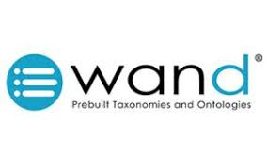






CPD Services Ecosystem
1. Cloud Pak for Data Base Services
Collect
Organize
Analyze
Deploy / Infuse
Data Virtualization
Watson Knowledge Catalog
(With IA, IGC, Refinery, InstaScan)
Watson Studio
Analytics Engine
Data Science: Model Design & Deployment
Db2 Warehouse
PostgreSQL
Dashboards
IBM Streams
Db2 Event Store
IBM Streams
Open Source Management
Watson OpenScale
Industry Accelerators (many)
Db2 Big SQL
NPS
Watson Machine Learning
OpenShift / Control Plane (Lite)
2. Premium Services (purchase license or BYOL)
Collect
Organize
Analyze
Deploy / Infuse
Db2 AESE
Virtual Data Pipeline
Infosphere DataStage Edition
Infosphere Regulatory Accelerator
Infosphere multi-cloud Data Mvmnt
Infosphere Entity Resolution
Master Data Management
Cognos Analytics
SPSS Modeler
Decision Optimization
Watson Explorer
Planning Analytics
Watson Assistant / Discovery
Watson API Kit (Speech to Text,
Text to Speech, Natural Language
Understanding)
Watson Financial Crimes Insights
Planning Analytics
3. Third Party Extension Services
Notes:
CPD services come in three tiers
Base Services - Free with CPD Enterprise license to optionally deploy. If not required, the architecture eliminates the need to spend cluster resources on a functionality that is not used. If needed, the service is easily installed on your cluster to receive that functionality. Examples are Data Virtualization, Db2 Warehouse (SMP or MPP) & Cognos Dashboards.
Premium Services - Services (from IBM) that you can purchase with your CPD license, afterwards, or install if you already have a license for that product (Bring Your Own License.)
Third Party Services – Extensions from IBM partners.

Slide 19
The Original* AI Ladder Described: AI vs. Cognitive systems vs. Machine Learning vs. Analytics
Artificial Intelligence
Branch of computer science dealing with the simulation of intelligent behavior in machines. It is the capability of machines imitating intelligent (usually human) behavior. AI has been around for many years, predating machine learning and the term “cognitive systems.” e.g. IBM Deep Blue beat the world champ at chess in 1996 by using brute force computer programming.
Cognitive systems
Simulation of human thought processes in a computerized model with self-learning systems that use data mining, pattern recognition and natural language processing to mimic the way the human brain works. e.g. IBM Watson beats Jeopardy! Champs in 2011 using an ML based predictive analytics driven by NLP. Modern AI applications can also be described as “Cognitive.”
Machine Learning
Branch of AI that employs statistical models and advanced algorithms to enable computers to become "intelligent" by "learning" from data in lieu of being specifically programmed. Can include predictive analytics, NLP, facial recognition, search engines. e.g. Google’s DeepMind beats Go champion by using ML neural networks and search.
AI
Cognitive Systems
Machine Learning
Analytics
Data
Analytics
The discovery, interpretation, and communication of meaningful patterns in data.
Data
Includes structured, semi-structured and unstructured datatypes in on-premises, public or private cloud, and hybrid environments.
The “AI Ladder”
* Presented in 2017 by Rob Thomas, IBM Senior Vice President, Cloud and Data Platform
Notes:
Let us take a minute to discuss various terms that are used in the industry. A good way to do that is to revisit the AI ladder.
The AI ladder has been drawn and redrawn in many ways since its inception and coinage by IBM’s Rob Thomas in 2017. Pictured here is his first incarnation and description of what steps it takes to get to AI.
The term Cognitive Systems was added to this ladder to help us understand that although today modern AI and Cognitive Systems are used synonymously, that was not the case originally. The computer science branch of AI has been around a lot longer than the terms “cognitive systems,” “machine learning,” “neural networks,” and so on. You can think of AI as a superset of all approaches that lead to machines acting intelligent in some way. That said, most modern AI systems can rightfully be describe as “Cognitive Systems” as well.
Machine Learning techniques are the most common modern way to get to AI, and is itself a higher form of analytics. Machine Learning is a technique, AI is the result.
The term Analytics is very broad and one that can include many simple methods including dashboard visualizations. When your financial institutions applications shows you a pie chart of your investment mix of bonds and stocks, or of your expenses vs. your income, those are applied analytics in an application. But it is not an example of machine learning, and surely is not AI.
However, simple analytic exercises like using dashboarding to understand business problems can be helpful in the development of machine learning models that can infuse AI into your applications. So, any kind of applied analytics can be a step up the AI ladder.
At the base of it all is data. Every kind of data. This was a point well made by Rob Thomas in that without data, there is no advanced analytics, no machine learning, no AI.

Slide 20






Cloud Pak for Data (CPD) Make your data ready for AI
There is
no AI
without IA
Infuse – Deploy trusted AI-driven business processes
Analyze – Scale insights with ML everywhere
Organize – Create a trusted analytics foundation
Collect – Make data simple & accessible
Strong Foundation – Built on “Cloud native architecture”
Notes:
In CPD, the updated AI Ladder is often depicted this way, with the rungs being Collect, Organize, Analyze, Deploy and Infuse. Notice that in both AI ladder depictions it starts with a foundation of data. It is not that the original AI ladder depiction was wrong, it is that the more updated version of the ladder emphasizes the importance of having well collected and organized data as its basis.
It has been said that there is no AI (Artificial Intelligence) without good IA (Information Architecture). You cannot get meaningful analytics of any kind without well trusted, governed and known data. So Cloud Pak for Data is a perfect foundation for AI because it starts with data that is collected in the appropriate way and then organized to be well trusted, governed and known.
Only then can modern analytic processing be done on it to lead you to an infusion of the results into your applications.

Slide 21
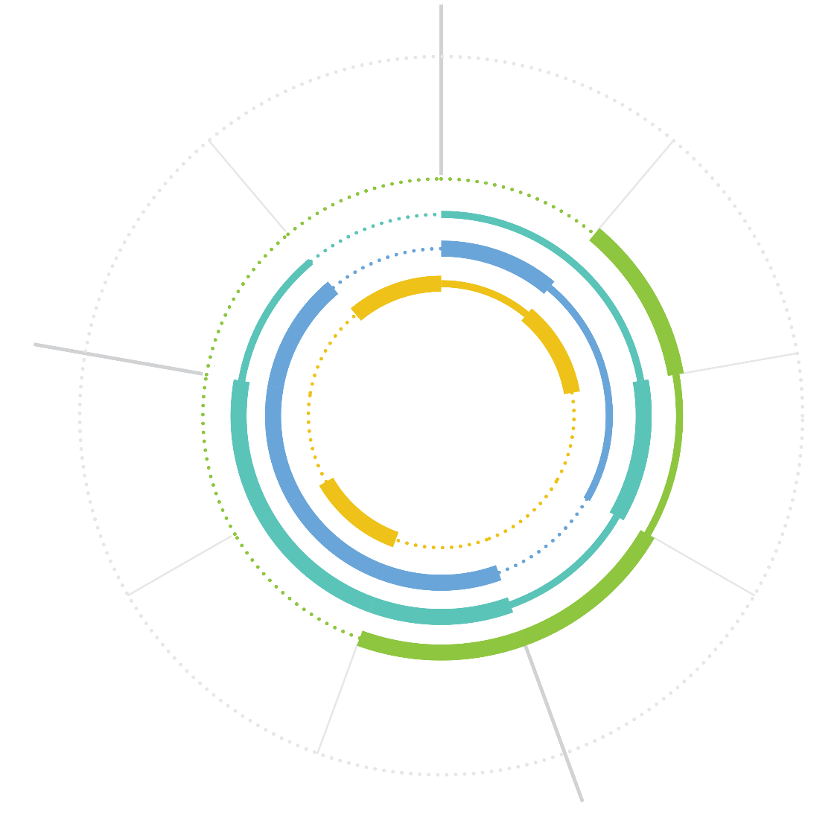






Cloud Pak for Data (CPD) Increases workforce productivity across the analytics lifecycle
Administrator / Architect | Data Engineer | Data Steward
Ensures the usability of the compute, network, storage, etc. | Architects data pipelines & ensures operability | Governs data and ensures regulatory compliance
DEPLOY /
INFUSE
COLLECT
Deploy, govern & manage models
Understand problem and domain
Communicate results
Access
data
Create and build model
Explore and understand data
Business Analyst | Data Scientist | Application Developer
Works with data to apply insights to business strategy | Dives deep into the data to draw insights for the business | Plugs into analysis and code to build applications
Evaluate
Transform: cleanse
Shape
ANALYZE
ORGANIZE
Notes:
The designers and developers of CPD understand that in most organizations, many different people representing many different personas will each play a role in the stages of Collect, Organize, Analyze and Deploy & Infuse.
Each of these personas can be more productive because they all share a common platform.

Slide 22
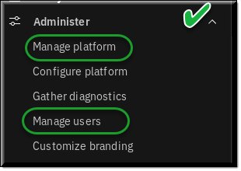
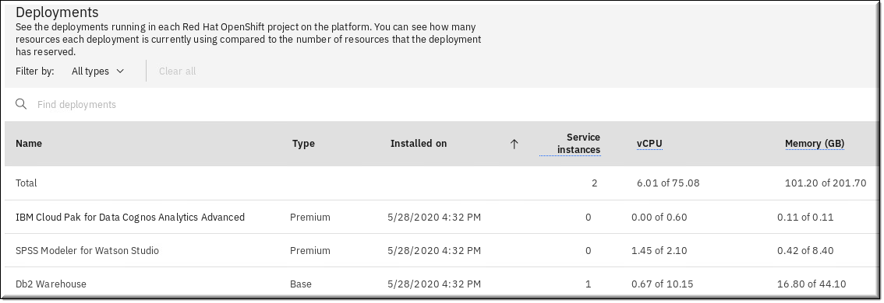
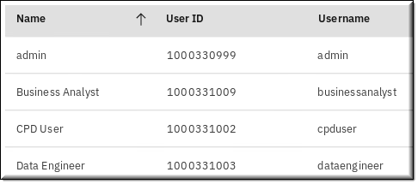
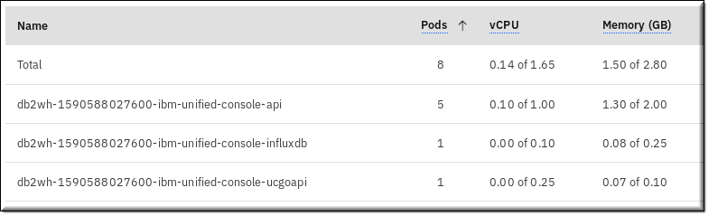
CPD Administration Administer and manage the platform
Notes:
The first topic will cover some basic administration functionality of CPD. This screen shows the “Administer” menu option from the main Navigation Menu.
Notice you can administer and manager your CPD platform from within the tool.

Slide 23
Business Use Case Lab 02 – Business Use Case: Customer Churn
Notes:
23
TOPIC and LAB - BUSINESS USE CASE: CUSTOMER CHURN

Slide 24

Trade Co. Challenges
Customer retention problem leading to declining revenue
Underperforming rules-based system to identify separation (churn) risk
Lack of centralized, vetted, and reliable data to ensure accuracy of analytics
Disparate analytical tools for reporting and model development
No simple way to infuse machine learning models into the customer facing Stock Trader Application
24
24
Notes:
Trade Co. challenges that will require a modern solution.

Slide 25
Separation (Churn) Risk: Current Rules Based System
Built Using Limited Data
Rules are developed using a single source of data that contains customer demographic information.
Manual Process to Develop Rules
Rules are manually developed based on the past experience of the marketing team. Rules are only updated once a year.
Low Overall Predictive Accuracy
Low overall predictive accuracy. We are both missing identifying customers who ultimately separate and incorrectly assigning high risk to customers who ultimately stay.
25
Notes:
How the process worked in the “before” scenario using a rules based system.

Slide 26
Separation (Churn) Risk: New Data Driven Approach
Incorporate Multiple Data Sources
Use vetted centralized transactional data along with customer demographics to understand separation behavior. Also, include the outcomes of the rules-based system for each customer where an accurate prediction was rendered.
Data Driven Process to Develop Machine Learning Models
Develop predictive models for separation risk that automatically discover and incorporate all the patterns in the data including interactions and contingencies.
High Accuracy from Adaptive Machine Learning
Models will classify separation risk with a higher overall accuracy and will adapt to changing patterns in risk to maintain that accuracy. Machine Learning models will incorporate all the understanding from the rules-based system and build on that to develop highly complex set of predictive conditions.
26
Notes:
How the process will work in the newly improved “after” application using Cloud Pak for Data.

Slide 27







Deployment: Stock Trader App. Integrated with AI
Customer Logs
Into Application
Customer Demographics &
Customer Churn
Data
If Separation Risk = High
No processing fee for next 5 trades and 1 free wealth management session with certified planner
If Separation Risk = Medium
No processing fee for next 5 trades
If Separation Risk = Low
No processing fee for next 2 trades
Personalized Retention Offers
Real Time Scoring
Machine Learning Model to Predict Separation Risk as High, Medium or Low
$
Transactional
Activity
Data
Generate Personalized Offer
Notes:
The left side of this illustration shows the relatively simple approach Trade Co. will take to retain customers. When a customer logs into their Stock Trader application, their likelihood of churn will be assessed based on the machine model that is infused into the application. It will make the appropriate offer based on that score.
The right side gives more detail on this approach. Transactional activity data (taken from their MongoDB JSON data) and the historical churn data (taken from the Db2 database based on previous rules based results) and the demographics information of the client are fed into the predictive model to produce a score in one of three levels:
High risk – giving the best offer
Medium risk – giving a good offer
Low risk – giving the least best offer

Slide 28




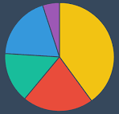




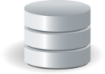
Stock Trader Application
Stock Trader Application with Infused ML
Cloud Pak for Data
Flat File of Monthly Sales Performance
1)
4)
Integrate Model into Application
(Stock Trader)
7)
Dashboard of Sales Performance (Monthly Metrics)
Dashboard of Churn Risk (Demographics Discovery)
Customer Demographics
2)
3)
5)
6)
8)
Historic Churn Risk Results
Organize Data: Discover, Govern
and Catalog
Transform Data:
Merge and Prepare data for Analysis
Build Machine Learning Model for Churn Risk (AutoAI and Notebook)
Manage and Deploy ML Model
Dashboard of Business Impact (Monthly Metrics after AI)
Customer
Activity
Combined Data:
Demographics
Churn Risk
Activity
Post analysis customer data
COLLECT
ORGANIZE
ANALYZE
DEPLOY / INFUSE
Notes:
This illustration outlines the steps within the CPD platform that will be taken to produce the final results.
In this step, a CSV flat file of monthly sales is analyzed with dashboarding to identify the declining traders and revenue problem.
In this step, customer churn and demographics data is collected, along with customer activity data.
In tis step the data is discovered to be automatically classified and cataloged and some of it is transformed.
In this step a dashboard of the churn risk is created.
In this step all of the collected data is joined together to be fed into a model creation step. It is tested and evaluated for accuracy.
In this step the model is deployed in the CPD platform
In this step the model is infused into the newly enhanced Stock Trader application.
In this step another dashboard will show how the newly enhanced application impacts the business.

Slide 29
Trade Co. Application “Stock Trader” – Before Microservices Application
Stock Trader
as a modern microservice application
OpenShift
IBM Cloud Public
Db2
Redis
Browser
Trader UI
Traditional JSP
Stock Quote
API Connect
Quandl
Portfolio
Loyalty Level
Trader UI
Node.js based
IBM MQ
Notification
Open Whisk
Slack
Twitter
IBM Cloud Pak for Data Workshop v3.0.1 / © 2020 IBM Corporation
Notes:
The infrastructure services Db2, MQ and Redis are shown in green whereas microservices are shown in blue.
The main advantage of microservice based application is the ability to modify, deploy, update and scale services dynamically and individually.
In modern microservice mesh architecture, it is now possible to run multiple versions of the same service in production and control the traffic dynamically based upon rules that can be defined outside of the service itself, eliminating the need to need to modify any of the microservice code.
The application shown here is the demo application that does not address all features and functions of a commercial application but gives you an insight into the concepts of application modernization. The OpenShift platform provides tooling to help you migrate your monolithic applications to a microservices-based architecture free of cost.
If your journey on this path has not yet begun, share this application with your development teams. It will provide you with the framework you need to start building your own microservice-based applications. You can find it at: https://github.com/IBMStockTrader

Slide 30
Trade Co. Application “Stock Trader” – After: Infused with ML Microservices Application
Stock Trader (enhanced)
as a modern microservice application
OpenShift
IBM Cloud Public
Db2
Redis
Browser
Trader UI
Traditional JSP
Stock Quote
API Connect
Quandl
Portfolio
Loyalty Level
Trader UI
Node.js based
IBM MQ
Predictive Analysis
Notification
Open Whisk
Slack
CPD
Twitter
IBM Cloud Pak for Data Workshop v3.0.1 / © 2020 IBM Corporation
Notes:
The addition here is the Predictive Analysis microservice that was delivered by Cloud Pak for Data. The Trader UI microservices have been changed to interact with this new microservice to offer the incentive award and based on the predicted churn possibility of the user.

Slide 31
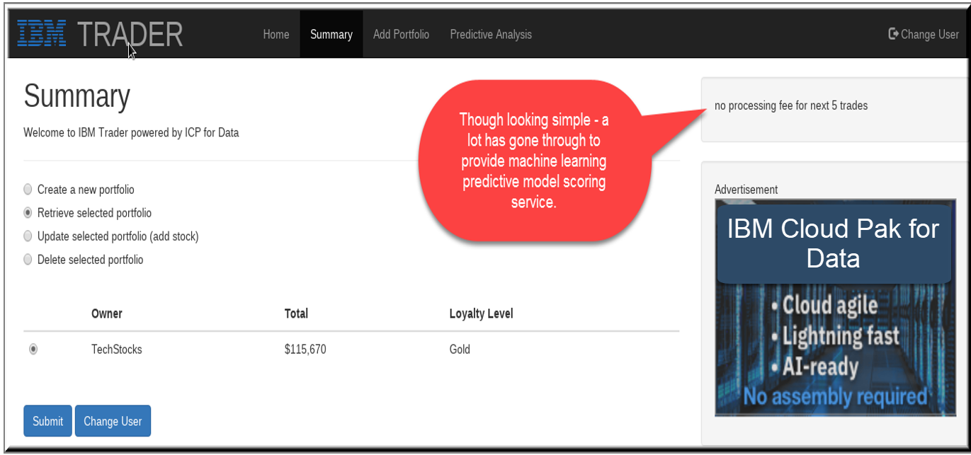
Stock Trader – After Monetizing the ML model
IBM Cloud Pak for Data Workshop v3.0.1 / © 2020 IBM Corporation
Notes:
The model API that was built using CPD is consumed through the Stock Trader application.
Shown here is the offer made to this user based on their likelihood of churn.

Slide 32
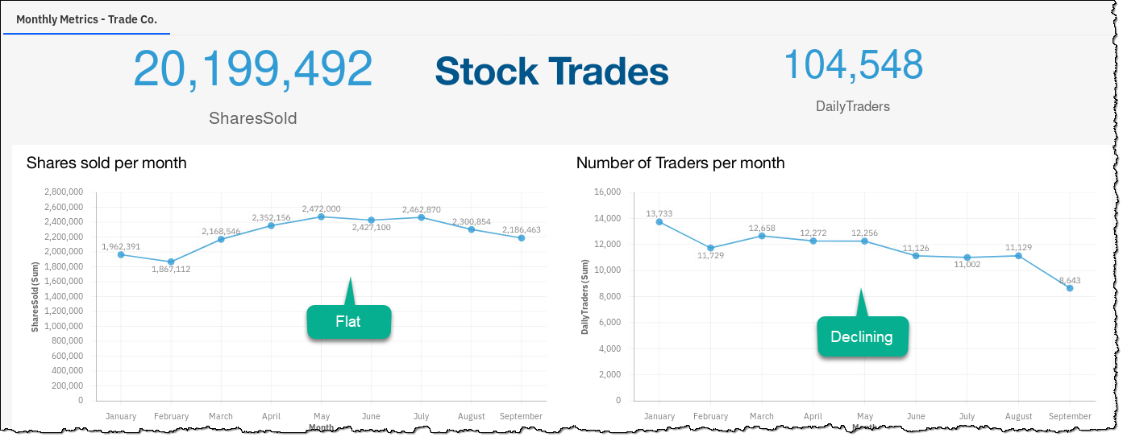
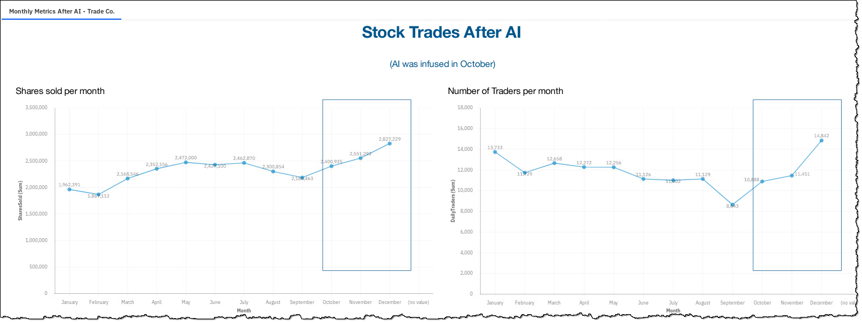
Trade Co. Dashboards Before and After deploying the CPD developed ML model
Before AI
After AI
Notes:
These dashboards show Trade Co.’s customer trading activity before and after the machine learning model was implemented.

Slide 33
IBM Analytics Modernization Workshop
Introduction Business Use Case | Lab 01 Lab 02
Collect: Connect Organize Collect: Virtualize | Lab 03 Lab 04 Lab 05
Analyze Deploy Infuse – OpenScale Infuse – Cognos Analytics Wrap up | Lab 06 Lab 07 Lab 08 Lab 09 Lab 10
Part 1
Notes:
Instructors: Perform the labs in this group together

Slide 34
IBM Analytics Modernization Workshop
Introduction Business Use Case | Lab 01 Lab 02
Collect: Connect Organize Collect: Virtualize | Lab 03 Lab 04 Lab 05
Analyze Deploy Infuse – OpenScale Infuse – Cognos Analytics Wrap up | Lab 06 Lab 07 Lab 08 Lab 09 Lab 10
Part 2
Notes:
Instructors: Perform the lectures in this group together

Slide 35
Collect Lab 03 – Collect: Connections Lab 05 – Collect: Virtualize
Notes:
35
TOPICS: COLLECT LABS - COLLECT: CONNECTIONS and COLLECT: VIRTUALIZE

Slide 36
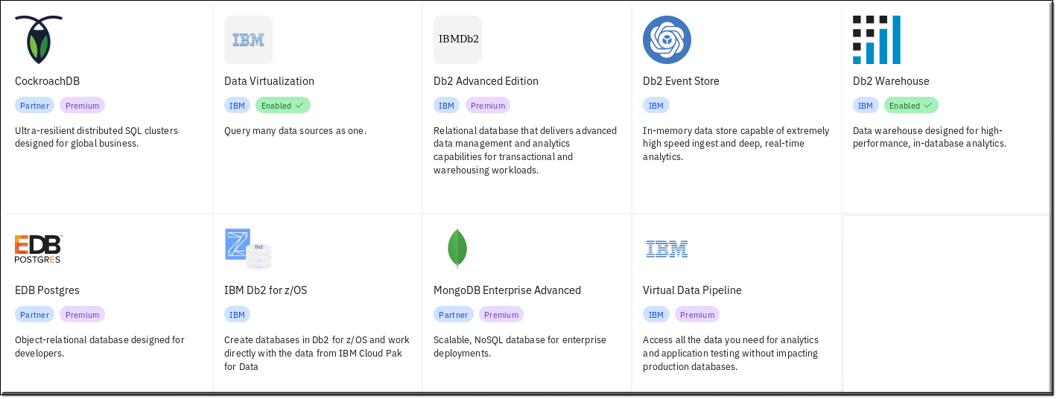
CPD Collect 1. Provision in-cluster databases
Provision, host, and manage these data sources directly on the CPD cluster
Notes:
These are the in-cluster database services available for CPD.
Premium means extra cost IBM offerings.
Partner means extra cost partner offerings.
Enabled represents those that have been added-on to the workshop cluster the attendees of the workshop will be using.

Slide 37
CPD Collect 2. Connect to existing data sources: IBM *
* Note: This list is constantly updated and shows what exists as of August 27, 2020.
Connect directly to these data sources and perform the CPD component functionality shown
IBM Data Sources | Cognos Dashboards | DataStage Edition | Data Virtualization | WKC | Watson Studio
Analytics Engine HDFS |  |  |  | ✔ | ✔
Classic Federation |  | ✔
Cloud object storage (IBM) |  | ✔ |  | ✔ | ✔
Cloud object storage (infra) |  |  |  | ✔ | ✔
Cloudant |  |  |  | ✔ | ✔
Cognos Analytics |  |  |  | ✔ | ✔
Compose for MySQL |  |  |  | ✔ | ✔
Data Set |  | ✔
Data Virtualization | ✔ |  |  | ✔ | ✔
Data Virtualization Mgr z/OS |  |  | ✔
PostgreSQL databases |  |  |  | ✔ | ✔
Db2 |  | ✔ | ✔ | ✔ | ✔
Db2 Big SQL |  |  | ✔ | ✔ | ✔
Db2 Event Store |  |  | ✔ | ✔
Db2 for i |  |  | ✔ | ✔ | ✔
Db2 for z/OS |  | ✔ | ✔ | ✔ | ✔
Db2 Hosted |  |  |  | ✔ | ✔
Db2 on Cloud |  | ✔ | ✔ | ✔ | ✔
Db2 Warehouse | ✔ | ✔ | ✔ | ✔ | ✔
Db2 Warehouse on Cloud | ✔ | ✔ | ✔ | ✔ | ✔
Distributed Transactions |  | ✔
DRS |  | ✔
IBM Data Sources | Cognos Dashboards | DataStage Edition | Data Virtualization | WKC | Watson Studio
External Source |  | ✔
External Target |  | ✔
HDFS via Hadoop |  |  |  | ✔ | ✔
Hierarchical |  | ✔
Hive via Hadoop |  |  |  | ✔ | ✔
Impala via Engine for Hadoop |  |  |  | ✔ | ✔
Informix |  | ✔ | ✔ | ✔ | ✔
Informix Enterprise / Load |  | ✔
ISD Input / Output |  | ✔
Java Integration |  | ✔
Lookup File Set |  | ✔
Netezza |  | ✔ | ✔
Planning Analytics |  |  |  | ✔ | ✔
Obj. Strg. OpenStack Swift |  |  |  | ✔ | ✔
PureData for Analytics |  |  |  | ✔ | ✔
WebSphere MQ |  | ✔
Z/os DVM sources (VSAM, IMS, Adabas, etc.) |  |  | ✔
BV
Notes:
This is the current matrix of all IBM data sources that can connect to CPD.
It should be noted that not all data sources can be used in all component functionality. For example, Db2 data sources can be used by any and all CPD functionality. A data set can only be used as a source for ETL. That said, an ETL job can be used to take a data set data and write it to the Db2 in-cluster database to be used anywhere in the platform.

Slide 38
CPD Collect 2. Connect to existing data sources: Third-party *
* Note: This list is constantly updated and shows what exists as of August 27, 2020.
Connect directly to these data sources and perform the CPD component functionality shown
Third-party Data Sources | Cognos Dashboards | DataStage Edition | Data Virtualization | WKC | Watson Studio
Amazon Redshift |  |  | ✔ | ✔ | ✔
Amazon S3 |  | ✔ |  | ✔ | ✔
Apache Cassandra |  | ✔
Apache Derby |  |  | ✔
Apache Hbase |  | ✔
Apache HDFS |  |  |  | ✔ | ✔
Apache Hive |  |  | ✔ | ✔ | ✔
Apache Kafka |  | ✔
Azure Storage |  | ✔
BDFS |  | ✔
Cloudera Impala |  |  | ✔ | ✔ | ✔
Dropbox |  |  |  | ✔ | ✔
Filesystem |  | ✔ |  | ✔ | ✔
FTP Enterprise |  | ✔
FTP |  | ✔ |  | ✔ | ✔
Generic JDBC |  |  |  | ✔ | ✔
Google BigQuery |  | ✔ | ✔ | ✔ | ✔
Google Cloud Storage |  | ✔ |  | ✔ | ✔
HDFS Generic web-HDFS |  |  |  | ✔
HDFS HttpFS |  |  |  | ✔
Hive JDBC |  | ✔ | ✔
Hive JDBC CDH |  | ✔ |  | ✔
Hive JDBC HDP |  | ✔ |  | ✔
Hortonworks HDFS |  |  |  | ✔ | ✔
Third-party Data Sources | Cognos Dashboards | DataStage Edition | Data Virtualization | WKC | Watson Studio
Looker |  |  |  | ✔ | ✔
MariaDB |  |  | ✔
MSFT Azure Blob & File |  | ✔
MSFT Azure Lake Store |  |  |  | ✔ | ✔
MSFT Azure SQL DB |  |  |  | ✔ | ✔
MSFT SQL Server | ✔ | ✔ | ✔ | ✔ | ✔
Minio |  |  |  | ✔ | ✔
Mongo |  |  | ✔ | ✔
MySQL |  |  | ✔ | ✔ | ✔
ODBC |  | ✔
OData |  |  |  | ✔ | ✔
Oracle |  | ✔ | ✔ | ✔ | ✔
Pivotal Greenplum |  | ✔ |  | ✔ | ✔
PostgreSQL | ✔ |  | ✔ | ✔ | ✔
Salesforce.com |  | ✔ |  | ✔ | ✔
SAP HANA |  |  | ✔
SAP Data Object |  | ✔ |  | ✔ | ✔
Snowflake |  | ✔ | ✔ | ✔ | ✔
Sybase Enterprise |  | ✔ | ✔ | ✔ | ✔
Sybase IQ / OC |  | ✔ |  | ✔ | ✔
Tableau |  |  |  | ✔ | ✔
Teradata |  | ✔ | ✔ | ✔ | ✔
Notes:
This is the current matrix of all third party data sources that can connect to CPD.
It should be noted that not all data sources can be used in all component functionality. For example, Oracle, SQL Server data sources can be used by any and all CPD functionality. Amazon S3 can only be used as a source for ETL. That said, an ETL job can be used to take Amazon S3 data and write it to a Db2 in-cluster database or an Oracle external database to be used anywhere in the platform.

Slide 39
CPD Collect 2. Connect to existing data sources: Data Files
Connect directly to these data sources and perform the CPD component functionality shown
Other Data Sources | Cognos Dashboards | DataStage Edition | Data Virtualization | WKC | Watson Studio
Comma Separated Value (CSV) files | ✔ | ✔ | ✔ |  | ✔
Microsoft Excel Spreadsheets |  |  | ✔ |  | ✔
Sequential File |  | ✔
Tab Separated Value (TSV) files |  |  | ✔
BV
Connecting to any of the data sources by service:
Service | Comment
Cognos Dashboards | You can use the local and remote data sets that already exist in your analytics projects. You can create connections by selecting Add data source from the analytics dashboard menu.
DataStage Edition | You can transform data that is in a catalog by searching for the data that you want to use and selecting Transform.
Data Virtualization | You can create connections that can be used to virtualize data from the following locations: 1) Connections page, 2) Data Sources page in the Data Virtualization service
Watson Knowledge Center | You can create connections that can be used in the catalog and connections that can be used to curate data.
Watson Studio | Ideally, you should use data that is already in a catalog by searching for the data you want there and add it to an analytics project. Alternatively, you can create connections that can be used in analytics projects from the following locations: 1) Connections page, 2) Assets page of the analytics project. You can also Add data from files.

Slide 40
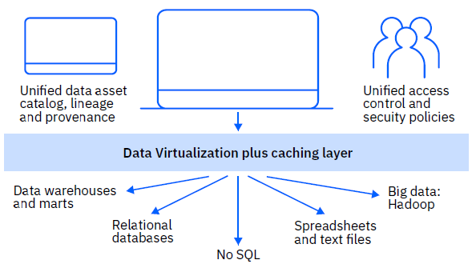
CPD Collect 3. Data Virtualization - Overview
Query across multiple databases and big data repositories which appear as one to an application
Data Virtualization in Cloud Pak for Data is a unique new technology that connects many data sources into a single self-balancing collection of data sources or databases referred to as a constellation
Analytics are submitted against the data at the source (data is not copied)
New algorithms are applied that support distributed SQL execution across heterogenous data sources
CPD
Notes:
The term “Data Virtualization” is used in many different ways and has many forms in the industry, so it is important to understand what CPD Data Virtualization (DV) means.
Most data virtualization approaches (like the more simple federation) means making various heterogenous data sources look like one, and that is true of CPD DV.
However, under the covers CPD DV has a self-balancing constellation with a caching layer that allows for a special kind of processing with new algorithms to support distributed SQL that is discussed in more detail on the next slide.
To accomplish this, CPD DV has a configured “instance” on the CPD cluster itself that requires dedicated compute (CPU and RAM) for this processing.

Slide 41
CPD Data Virtualization Constellation “Computational Mesh” benefit
Classic Federation & Edge Computing
To be clear: Federation is a form of Data Virtualization and has been used successfully for many years in IBM products like Db2
coordinator
Query
Query Result
Query issued against the system
A coordinator receives the request and fans the work out to edge nodes
Edge nodes individually perform as much work as they can based on their own data. Individual results are sent back to the coordinator for final merging and remaining analytics.
Coordinator receives intermediary results from all edge nodes, merges results, and performs remaining analytics
CPD Data Virtualization uses a new Computational Mesh * approach which meets the performance demands of today’s modern data access requirements
New Computational Mesh
* Note: this is a work in progress. Remote Connectors with data source support is available today.
coordinator
Query
Query Result
Query issued against the system
A coordinator receives the request and fans the work out to edge nodes
Edge nodes self organize into a constellation where they can communicate with a small number of peers. Nodes collaborate to perform almost all analytics, not only analytics on their own data.
Coordinator receives mostly finalized results from just a fraction of nodes. Completes the final work for the query result.
Notes:
CPD DV utilizes a Computational Mesh approach via its constellation. This in essence means that the edge nodes participate with each other to perform analytics together, rather than singularly as they do with more simple federation virtualization.
The edge nodes in CPD DV can collaborate to perform almost all of the analytics required before returning results back to a coordinator from just a fraction of the edge nodes. This is in contrast to simple federation which requires all the edge nodes to return intermediary results to the coordinator, requiring the coordinator to complete the analytics processing there from all nodes.

Slide 42



CPD Data Virtualization Data Governance is built in
Data Engineer / Business User (business terms)
Virtualized tables
Completely governed
Searchable in the Enterprise Data Catalog
Data Sources
By using this flow, the DV Table will be published to catalog with fingerprint information collected (quality, profile, classification, assign business terms, Sensitive Information Detection)
If any PII data is present, the system will automatically flag the table in the catalog with a PII Label
Data Masking Services can de-identify the sensitive information when user attempts to view the data
Connection
s
Data Virtualization Services
Create DV Table
DV-Table-1
Db2
Add DV Table to a Project
Projects
Table-1
Table-2
Table-x
DV-Table-1
…
Oracle
Publish select / all discovered metadata to EDC to be profiled for Data Virtualization
Automatic Discovery Task
Db2 z
Teradata
Connection
s
Data Catalog
Table-1
Table-2
Table-x
DV-Table-1
Policies & Rules
Lineage
PII Labels
…
Add to a Project
Discovery
Profile
Classify
Quality
Buss Term
Identify PII
Discovery Results
…
Data Scientist
Search
Review & Approve
Publish to Catalog
Start an auto- discovery task
Data Steward
Notes:
CPD virtualized tables (and virtualized views) participate in the same discovery and cataloging process of any other data source. Thus, they are subjected to governance polices and rules.
Note: a virtualized table is a virtualization of a data source like a database table. A virtualized view is a join between two virtualized tables.

Slide 43
CPD Data Virtualization With Watson Knowledge Catalog (WKC) built in
Analytics Tools
Portals
Web Services
Consumers
Applica-tions
Mobile Apps
Watson Knowledge Catalog
(Metadata)
Consumer Layer
(Interface Provisioning)
Provides the ability to search, view, access, manipulate, and analyze data
No need to know or understand its physical format or location
No need to move or copy it
Virtualization Layer
Virtualization
Platform
Caching &
Optimization
Connection Layer
(Adaptors)
Data Lakes
NoSQL
Ware-houses
Files
Marts
Web
Services
Data Sources
Cloud
Applica-tions
Notes:
This illustration highlights the fact that virtualized data in CPD is part of the Watson Knowledge Catalog, thus making its lineage and metadata well known and easily understood.

Slide 44
CPD Data Virtualization Benefits and use cases
Benefits
Simple:
Self-discovering, self-organizing cluster
Joins provide a one source input to analytics
Flexible:
Once established, it is easy to add new sources to the constellation
Integrates disparate data assets with simple automation, providing seamless access to data as one
Scalable:
Can access thousands of sources, IOT and edge devices
Cost Effective:
Leverages the compute resources of source systems to execute the SQL
Secure:
Inherits privileges & masking policies of the data sources
Built in governance, security, and access control
Use Cases
Data Scientists:
Significant productivity increase getting access to sources discovery and assembly of data sets
Current State answer requirement:
Current state required for up-to-date analytics
One time access to data, then throw it away
e.g. “How much cash is ‘on hand’ across our branches worldwide?” “What is our current ‘claims’ liability?”
ETL and/or Data Governance saturation
Self-service – In the event that Data Engineers cannot keep up with business demands for access to data

Slide 45

CPD Collect 4. External Data Sets
The Weather Company
Equifax
People Data Labs
BCC
Historical Weather Data
Demographic Consumer Data
People Data
Dataset of ~1.5B profiles consisting of both b2b and b2c data on each person
3 Years of Historical Weather Data
Current Weather Conditions
Weather Forecast Data
Location Look-up Services
Industry Accelerators (Retail & Manufacturing)
Ability to Pay
Economic Cohorts
Income 360
Wealth Complete Data
IXI-Data
Credit Styles Pro
Data is accessible via an Enrichment API or Data License
Real Time Stock Data
Real Time Stock Market Data
90-day trial
Premium
Premium
Premium
Notes:
Transactional data is central to your business. But if you only analyze your internal transactional data, your analysis is incomplete. Complement your data with external data sets that give you a 360-degree view of your business landscape. The data in the external data sets can help you complete a more comprehensive analysis that can help you make better decisions.
Cloud Pak for Data has partnered with industry leaders to provide easy and seamless access to external reference data that you can use to enrich your transactional data. Some of the data sets provide historical data, while others provide real-time data.
The data sets make it easy for data scientists to access the data that they need from the same platform where they run build and run their analytic models.

Slide 46
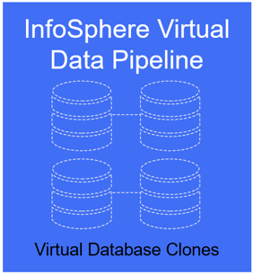
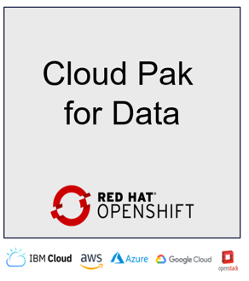
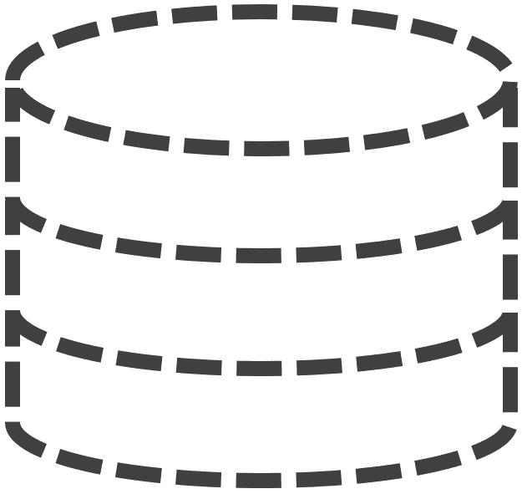



CPD Collect 5. Premium Service: Virtual Data Pipeline – Overview
Provision and refresh analytics and test data in minutes
Virtual Data Pipeline in Cloud Pak for Data is a service that allows users to instantly provision virtual database copies to work with near real-time for data analytics and application testing, AI model training and testing, and data virtualization.
Accessing production data quickly and securely can be a challenge:
Risk: Accessing Production data can impact operations and present a security and data privacy risk
Time Consuming: Moving data to data warehouses and marts or creating duplicate copies can result in stale data
Cost: Creating multiple copies and versions of data for each functional area uses a lot of storage and increases costs
+
=
Near-Instant
“Virtual” Copies
Self Service
Automated Refresh
Notes:
Virtual Data Pipeline Value:
Accelerates analytics and testing with Near-Instant “Virtual” Copies real-time data
Self-service historical point in time access to test data and increased productivity
Reduces security risks with secure virtual copies
Keeps data used for testing, protection and analytics in-synch with production data
Eliminates impact on production data servers while radically reducing infrastructure costs
Integrates with DevOps Pipeline through Open REST API

Slide 47
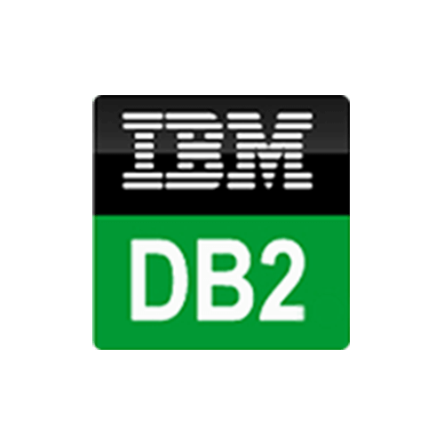

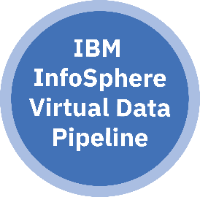

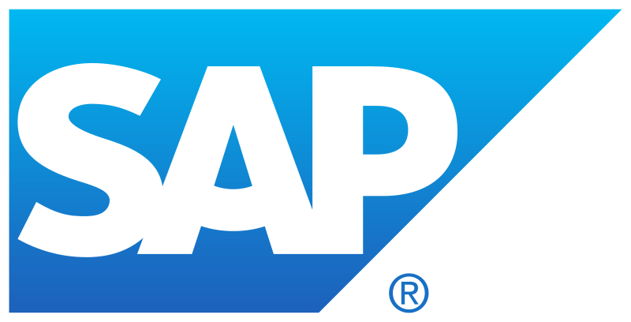

Virtual Data Pipeline Cost savings example
0 TB
DEV
Capture, clone and serve virtual database copies
3
Self service virtual copies
0 TB
QA
1
0 TB
ANALYTICS
2
Capture app consistent data
0 TB
PERF TEST
1 TB
0 TB
UAT
Store VDP gold copy on any storage
0 TB
PRE-PROD
0 TB
RECOVERY
Instant clone creation
1.1 TB storage used
90% Storage Savings
Source examples
0 TB
INTEGRATION
Notes:
Virtual Data Pipeline
Creates near-instant virtual copies of databases with self-service roll back in time
Creates initial snapshot or dump of source data, updates it incrementally
Applies data masking through workflow and provides role based access controls
Use Cases
Clone and query virtual data without the need to move any data
Train models on the same production data copies at different snapshots points in time
Access historical point in time copies and perform analytics
Quickly restore for compliance audits or similar purposes from snapshots
“Rehydrate” copies from one location to another

Slide 48

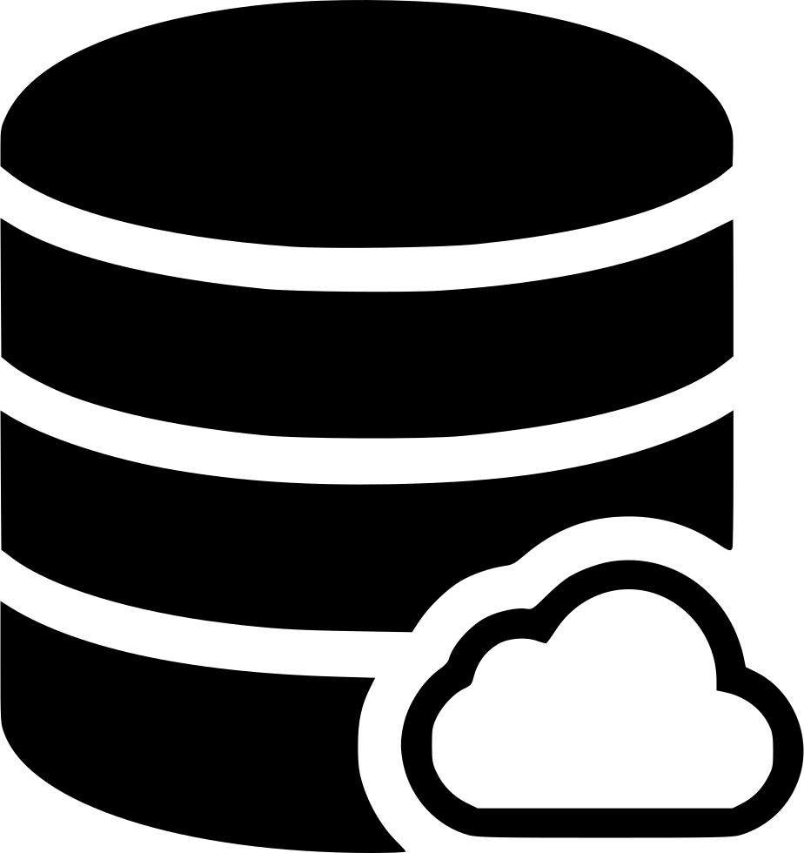
Virtual Data Pipeline Multi-cloud data management example
3
Manage Multi-cloud data sources from a single pane of glass
Replicate to public cloud or another data center
VDP
Cloning
&
Recoveries
VDP
Cloning
&
Recoveries
1
IBM Cloud
Google Cloud
2
Capture hybrid
multi-cloud
data sources
for CPD
IBM
VDP
Cloning
&
Recoveries
Cloning
&
Recoveries
VDP
VDP
VDP
AWS Cloud
Oracle Cloud
Store VDP gold copy on any storage
VDP
Cloning
&
Recoveries
VDP
Cloning
&
Recoveries
Azure Cloud
VMware Cloud
DATABASE AGNOSTIC
STORAGE AGNOSTIC
CLOUD AGNOSTIC
Notes:
VDP Business Value:
70% less data to move across your network
90% less data to store
90% reduction in TCO

Slide 49
Organize Lab 04 – Organize
Notes:
49
TOPIC and LAB: ORGANIZE

Slide 50




CPD Organize Watson Knowledge Catalog (WKC)
AI Lifecycle
Model Improvement
Ground Truth gathering
WKC is installed when you install any of the following services:
Watson Studio, Watson Machine Learning, Watson OpenScale
Runtime Monitoring
Data Cleansing
Model Deployment
Feature Engineering
Model Validation
Model Selection
Ensemble
Parameter Optimization
Data Scientists
Data Analysts
Business Analysts
Search and find relevant data
Prepare data for consumption and analysis
Consume and analyze the data
Rate, comment on and share the data
Enterprise Data Consumption
Data Stewards
CDO
LOB Risk
LOB Product
Manage metadata repository
Manage Reference Data
Data governance workflow
Discover metadata assets
Classify data assets
Data stewardship
Build data glossary
Data ownership
Data lineage
IBM Watson Knowledge Catalog on Cloud Pak for Data
Enterprise Data Governance
End-to-End Platform for Business-Ready Data
Quality Analysts
Profile data
Understand, monitor and
remediate data quality
Apply validation rules
Enterprise Data Quality
Notes:
Watson Knowledge Catalog is automatically installed when you install any one of these services:
1) Watson Studio
2) Watson Machine Learning,
3) Watson OpenScale
WKC allows the various personas shown on this slide to perform Data Quality, Data Governance and Data Consumption activities. These will be shown in more detail on the next slides for this section of the presentation.

Slide 51
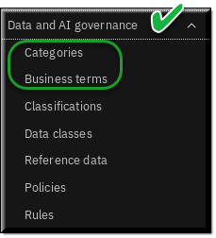
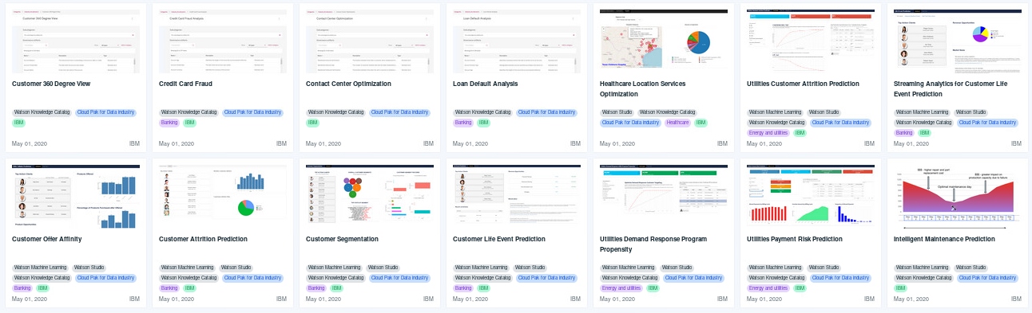
CPD Organize Data and AI governance: Categories and Business terms
Categories provide logical structure to a business glossary
Business terms standardize definitions of business concepts
Manually create Categories and Business Terms
Import Categories and Business Terms from CSV or XML files
Import a Glossary from an industry accelerator
Notes:
The definition of a Glossary in CPD is the creation of Categories and Terms. WKC supports these.
Categories
Categories provide the logical structure for the glossary so that you can browse and understand the relationships among terms and categories in the glossary. Categories can be organized in a hierarchy based on their meaning and relationships to one another.
The category hierarchy reflects how a user might search for information. A common strategy is to divide the business by subject areas, such as customers and products. A second strategy is to divide the top-level categories by departments such as Marketing, Finance, and Human Resources. For large companies that have independent business units such as Hardware, Software, and Services, another strategy is to organize the business units into top-level categories. For example, the top-level category for the Hardware business unit might be hardware, which has the subcategories automotive, home, electronic, and security.
A category can contain other categories and terms. In addition, a category can reference terms that it does not contain. For example, the category named Customer Summary has a subcategory named Customer Expense Summary. The category has a term named Credit Card Risk Score and references the term Credit Card Risk.
Terms
A term is a word or phrase that describes a characteristic of the enterprise. Terms are the fundamental building blocks of the glossary. Each term has a parent category, but it can also be referenced by other categories. When you create a term, you need to provide a meaningful name. Terms can be assigned to other terms, and to other asset types as well.
Before you create terms, you must define their meaning and use for the organization to ensure clarity and compatibility among departments, projects, or products. You can use the following guidelines. If the term name is long, use spaces instead of underscores or hyphens to break up the name. Otherwise, when long names are shown in results tables, the name does not wrap and the adjacent columns are narrow. For example, instead of Northeast_Office_Billing_Address, use Northeast Office Billing Address.

Slide 52
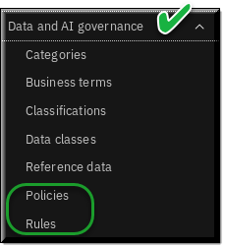
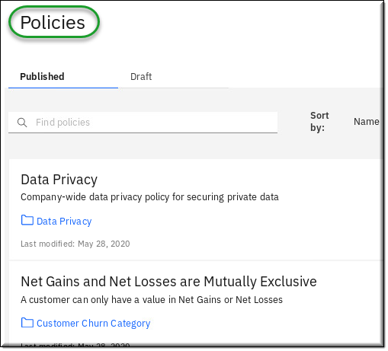
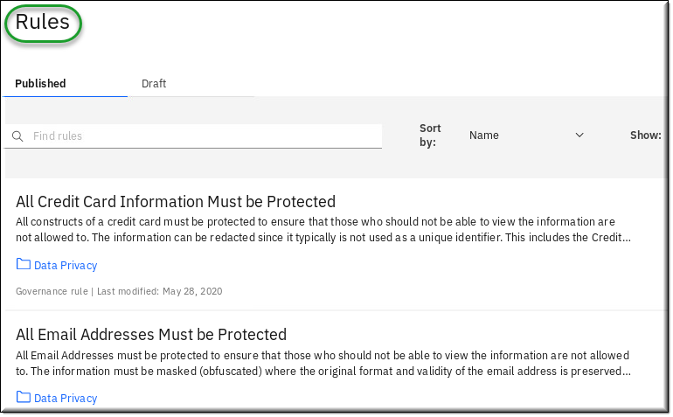
CPD Organize Data and AI governance: Policies and Rules
Policies describe how to control data and consist of one or more rules
Rules describe the criteria for compliance with business objectives
Notes:
Governance is enforced in CPD by Policies and Rules in WKC.
Information Governance Policies
An information governance policy is a natural-language description of a governance subject area. Each information governance policy can contain multiple information governance subpolicies or reference one or more information governance rules. When you create an information governance policy, it must fulfill a business objective, and be relevant and understandable to all users of the policy. When it contains subpolicies, the parent information governance policy needs to be sufficiently broad to encompass all of its subpolicies.
For example, an information governance policy High Quality Data states that data must meet a high quality standard. A subpolicy of High Quality Data called High Quality Customer Data states that customer data must meet a high quality standard. The High Quality Customer Data policy references an information governance rule called Postal Codes Verification. This rule states that customer addresses must use valid postal codes, as provided by the post office.
Information Governance Rules
An information governance rule is a natural-language description of the criteria that are used to determine whether information assets are compliant with business objectives. Generally, information governance rules are derived from information governance policies and are more specific. The rules define the actions to take in specific situations to implement the policy. An information governance rule can be referenced by one or more information governance policies.

Slide 53
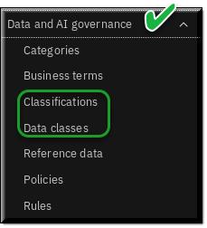
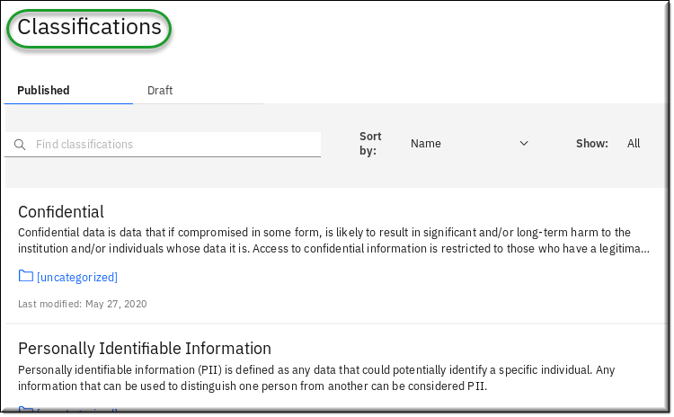
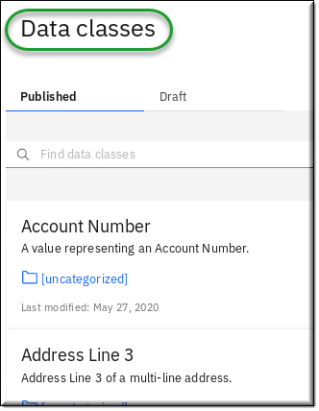
CPD Organize Data and AI governance: Classifications and Data classes
Classifications describes the sensitivity level of data
Data classes describe the contents of data in a column in a structured data set
Notes:
WKC supports the use of classifications and data classes.
Classification describes the sensitivity level of data. In catalogs, a classification describes the sensitivity of a whole data asset to help catalog members understand the asset. You can use classifications to describe business terms, data classes, reference data sets, and governance rules. In data protection rules, you can include classifications in conditions to identify the type of data to restrict.
These predefined classification artifacts are provided with Watson Knowledge Catalog:
None - The data does not contain any type of sensitive information.
Sensitive personal information (SPI) - Sensitive personal data is defined as personal data consisting of information relating to an individual with regard to racial or ethnic origin; political opinions; religious beliefs or other beliefs of a similar nature; trade union membership; physical or mental health or condition; sexual life; or any criminal or alleged criminal history of a person.
Personally identifiable information (PII) - Personally identifiable information (PII) is defined as any data that could potentially identify a specific individual. Any information that can be used to distinguish one person from another can be considered PII.
Confidential - Data that if compromised in some form, is likely to result in significant and/or long-term harm to the institution and/or individuals whose data it is.
Data classes describe the contents of data in a column in a relational or structured data set. Data classes are assigned to columns when profiling a structured data asset and shown on the Profile page in a catalog or project.
Watson Knowledge Catalog provides a predefined set of data classes. Some data classes are categorized into groups, for example:
If you select Date, it also includes Date of Birth.
If you select Driver’s License, it also includes all driver licenses.
There are many other data classes, too many to list here.

Slide 54
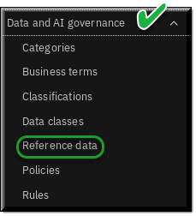
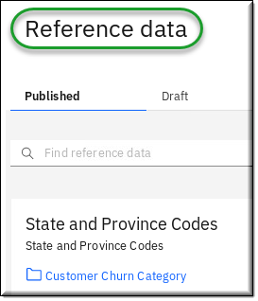
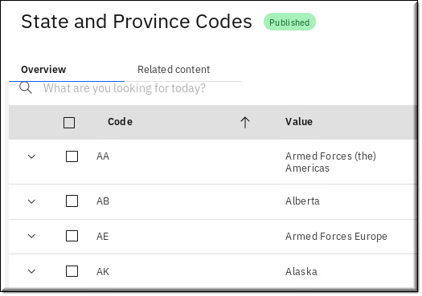
CPD Organize Data and AI governance: Reference Data
Reference Data Sets define list of permissible values that are allowed for use within a data field.
May be referenced by Business Terms, Policies, Rules and Data Classes

Slide 55
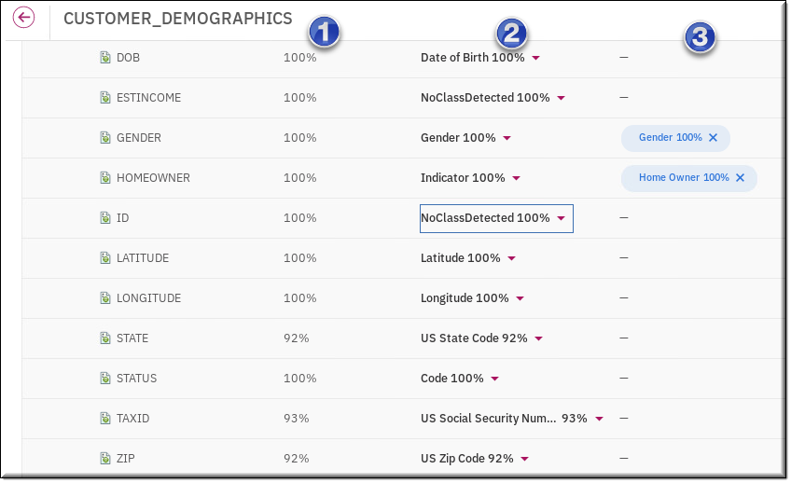



CPD Organize Auto-discover assets
Data Discovery
Use machine learning based auto-discovery to:
Analyze data quality
Analyze columns (Classify data)
Assign Business terms
You can perform discovery with data sampling to allow for self-service data access with a search.
Notes:
Data Discovery
The data discovery feature in CPD enables you to catalog data across your enterprise to make it easier to search for, govern, and use the data in different machine learning initiatives.
For Select the tasks that you want to run, check all of the following boxes:
Classify data
Analyze data quality
Assign business terms

Slide 56
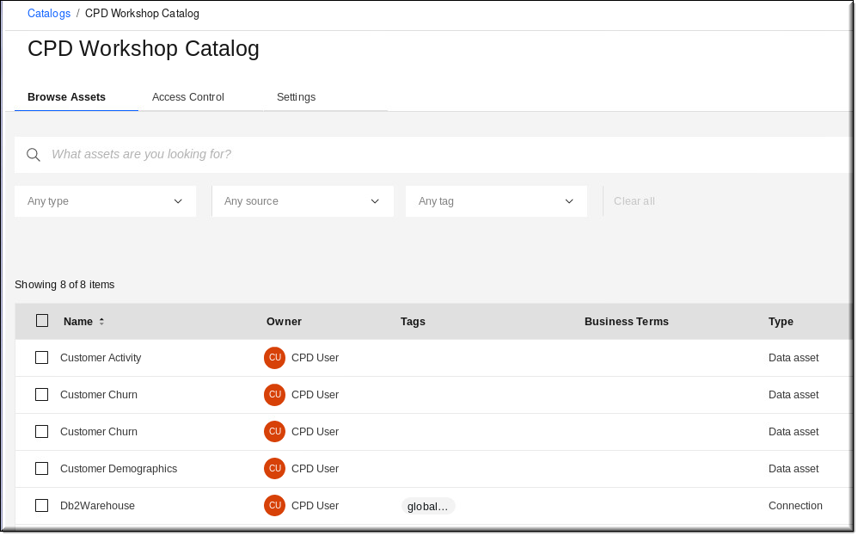
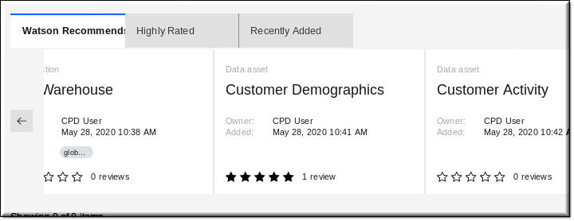
CPD Organize Publish to a catalog
Catalog and govern your assets

Slide 57
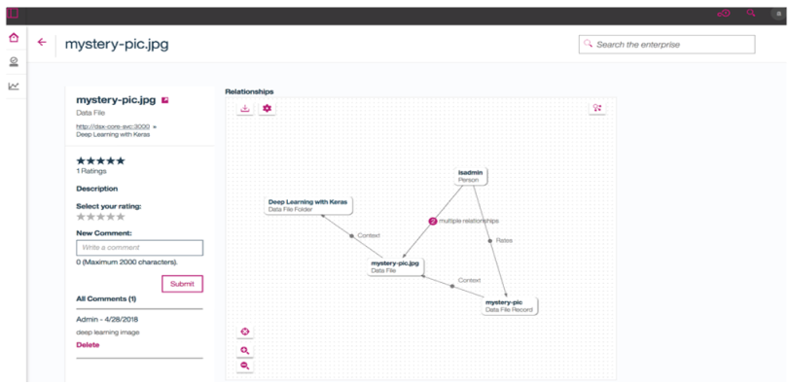
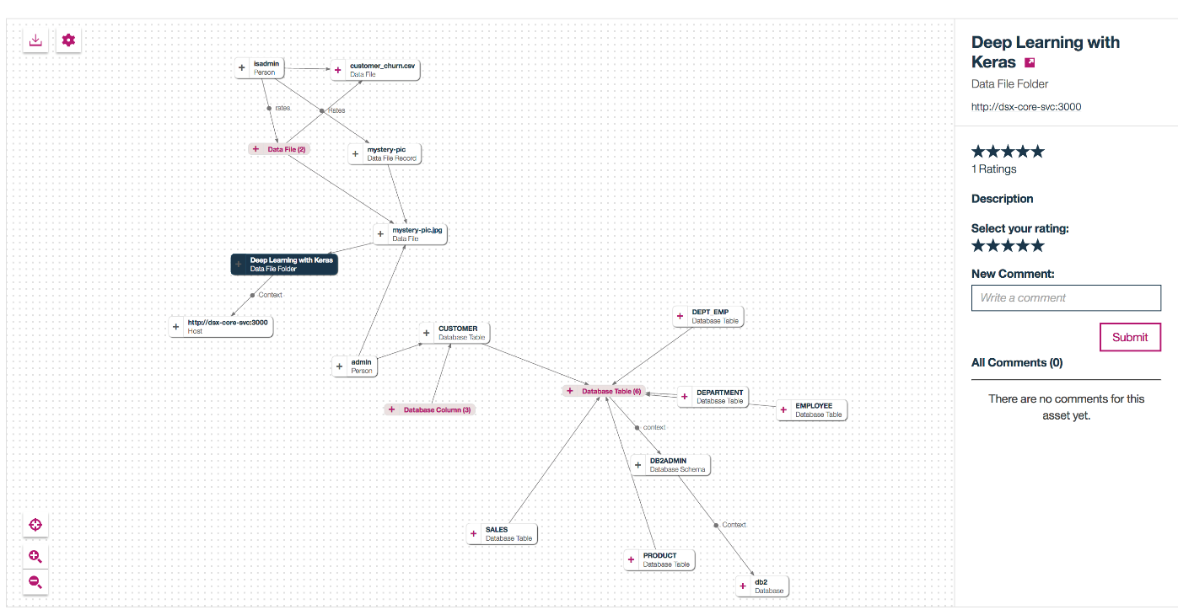
CPD Organize Relationship graph with explorer
Explore relationships between data assets, terms, analytic assets, users, etc.
Gain in-depth understanding of metadata through crowdsourcing (e.g., ratings, comments) and machine learning
Explore deeper to understand context and usage patterns
Notes:
Graph explorer enables you to see how assets are related to one another in your organization. With complex interconnections, graphical depiction of such relationships helps in understanding the structure of your data. While analyzing the relationships, you might discover unexpected correlations between your assets, which might be crucial in making the right decisions.
Each relationship has direction and name. You can expand and collapse nodes. You can display details of assets such as ratings and comments.

Slide 58
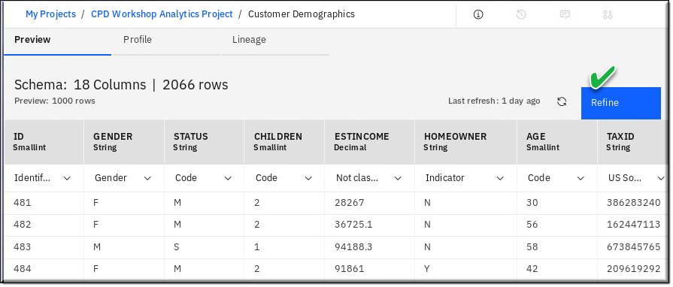
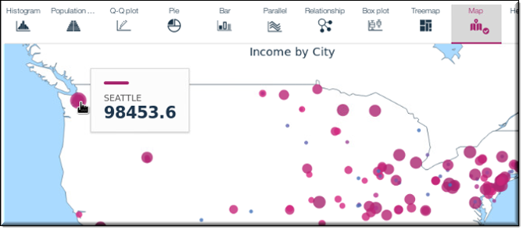
CPD Organize Refine data with visualizations
Refine can cleanse and shape tabular data with a graphical flow editor using functions and logical operators.
Use it to remove data that is incorrect, incomplete, improperly formatted, etc.
Shape the data by filtering, sorting, combining or removing columns. You can create a Data Refinery flow as a set of ordered operations on the data to run repeatedly any time.
Data Refinery also includes a graphical interface to profile data to validate it with 20+ customizable charts that give perspective and insights into the data.
Notes:
Refine is installed with either Watson Studio or Watson Knowledge Catalog service.
Data format is Avro, CSV, JSON, Parquet, or text data asset or a tables in relational data sources.
Data size Any. Data Refinery operates on a sample subset of rows in the data set. However, when you run a job for the Data Refinery flow, the entire data set is processed.

Slide 59
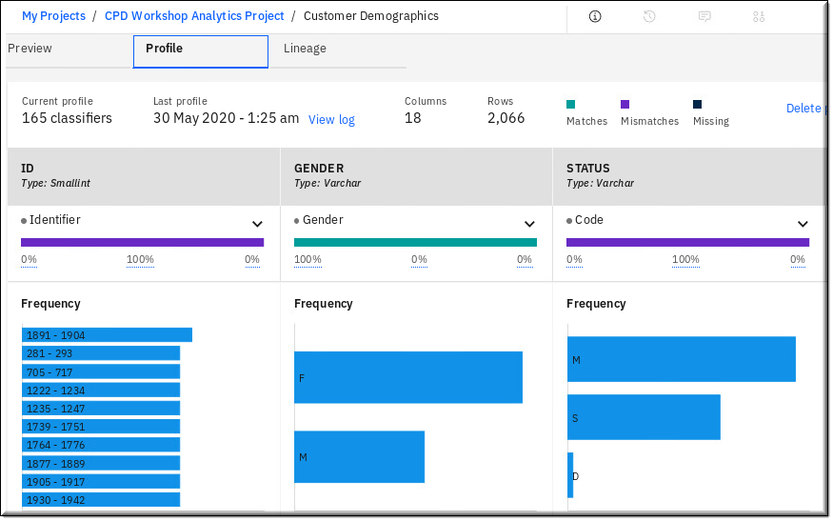
CPD Organize Profile data
The Profile of a data asset includes generated metadata and statistics about the textual content of the data.
All catalog or project members can see data asset profiles.
Profiles are automatically created:
In catalogs, profiles for unstructured data assets are created automatically, regardless of whether policies are enforced
In governed catalogs, profiles for structured data assets are created automatically
Profiles can be manually created:
In ungoverned catalogs for structured data assets
In projects for both structured and unstructured data assets
Notes:
You must have the Admin or Editor role in the project or catalog to create or update a profile.
Data assets that contain textual data have profiles. The profile of a data asset includes generated metadata and statistics about the textual content of the data. You can see the profile when you open the data asset in a catalog or project and go to the asset’s Profile page. All catalog or project members can see data asset profiles.
The profile of a data asset that contains relational or structured data shows information about each column in the data set, based on the first 5000 rows of data. The profile shows the frequency of the inferred data classes and statistics about the data for each column. Data classes describe the contents of the data in the column: for example, city, account number, or credit card number. Data classes are necessary to mask data with policies. The data classes appear for each column on the asset’s Overview page as well as on the Profile page.
These types of relational and structured data are profiled by column:
Data assets from a connection to the data sources listed here.
Partitioned data assets that consist of partitioned files in a folder of the local file system.
Data assets from files in a folder of your local file system with these formats:
CSV
Avro
Parquet
However, structured data files are not profiled when data assets do not explicitly reference them, such as in these circumstances:
The files are within a folder asset. Files that are accessible from a folder asset are not treated as assets and are not profiled.
The files are within an archive file. The archive file is referenced by the data asset and the compressed files are not profiled.
In catalogs with policy enforcement, profiles for structured data assets are created automatically.
In projects and in catalogs without policy enforcement, you must create profiles for structured data assets

Slide 60
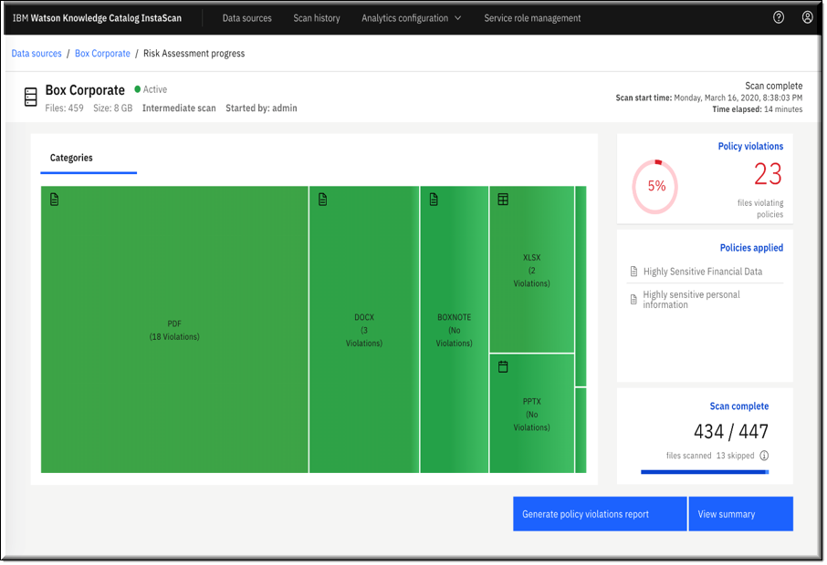
CPD Organize InstaScan
InstaScan can perform risk assessments and compliance checks of unstructured data
Scan email, PDFs, word processor documents and images
Quickly determine which areas have high concentration of sensitive information and prioritize hot spots
Automatically apply classification labels to data that violates corporate policies
Create and share ongoing compliance reports with CISO or regulators
Integrates with Box Shield to provides a comprehensive data privacy solution for unstructured data in Box

Slide 61

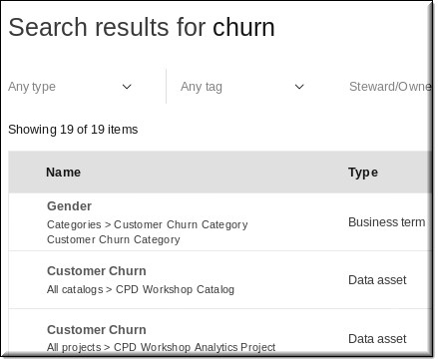
CPD Organize Search for data
Relevancy of search results factors:
Text match | The provided text is searched in the asset name & description, where name contributes more to the higher place in the result list.
Asset rating | The higher the average rating the asset has, the higher it is on the results list.
Comments | The higher the number of comments, the higher the asset is on the results list.
Context match | The search results list might contain the closest neighbors of assets that are returned based on the text match.
Modification date | The assets that were modified recently are more likely to be returned in the search results.
Quality score | The higher the score, the higher the asset is on the results list. Quality score applies to database tables, views & columns, design tables, views & columns, data file records & fields.
Usage | The more relationships of type uses an asset has, the higher it is on the results list.
Notes:
Technical details on how this works
Initialize: Create Janus graph schema in Cassandra and Search Index in Solr
Type Registry: Store definitions of entity type relationships (assets and others) as well as their properties in Cassandra
Read messages from Kafka and write to Janus graph, Store create / update / delete vertices / edges in Cassandra
Get Type info from Type Registry
Send requests to Scheduler to recalculate scores for modified vertices and their neighborhood
Enterprise Search: Receive REST requests from GUI and run full text searches, rank the results, provides additional graph information
Scheduler: Run jobs to recalculate scores and write them to Janus graphs

Slide 62

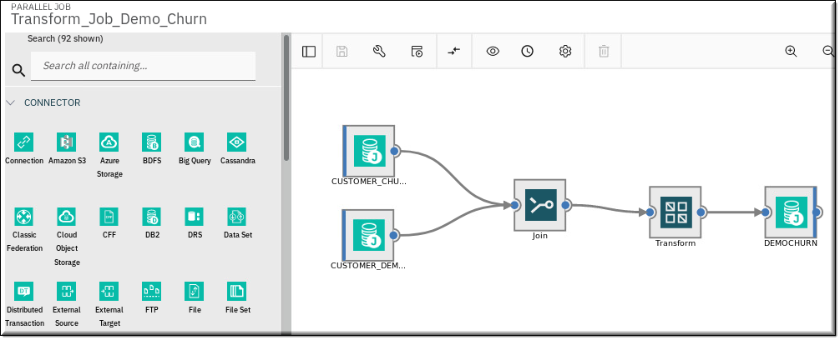

CPD Organize DataStage - Transform and migrate data, build and execute ETL jobs at scale
Use powerful data transformation capabilities
ML infused Smart Job Clustering, Smart Job Assist and automated job sequencing
Design once, run on any-cloud using Kafka
Remotely execute job for co-located access to data, satisfy geo-political requirements and save costs
In-line data quality and governance to build trusted data when the data is being delivered to a target environment such as a data lake
Create CI/CD pipelines with GitHub
Notes:
Use CPD to transform data that provides enriched and tailored information for your enterprise.
You can create, edit, load, and run transformation jobs. CPD has features like built-in search, automatic metadata propagation, and simultaneous highlighting of all compilation errors. Developers can use these features to be more productive.
Search: Find what you need fast by using the flexible Search feature.
Automatic metadata propagation: CPD automatically propagates metadata from one stage to the other stages later in the job, increasing productivity.
Highlighting of all compilation errors: CPD highlights all errors and gives you a way to see problems with a quick hover over each stage, so you can fix multiple problems at the same time before recompiling.
The Transform data page of CPD features the following tabs, which you use for quick access to essential actions:
Projects
Connections
Table definitions
Jobs
Parameter sets

Slide 63


CPD Organize Open Source Software Management
Open Source Software Management is:
A centralized inventory of approved open source packages to ensure code quality & security
A vehicle for self-service open source consumption and workflow requests for developers
A correlation of vulnerabilities across open source portfolio: highlight security risks
An infusion of collaboration by allowing developers to rate and comment on opensource packages
A set of dashboards for CIOs to manage risks and accelerate innovation with OSS

Slide 64

CPD Organize Master Data Connect
Master Data Connect is an extension of:
IBM Master Data Management Advanced Edition
IBM Master Data Management Standard Edition
Services the majority of the MDM system workload - specifically reading MDM data.
Provides clients the opportunity to deploy a read-only instance of their master data entities on Cloud Pak for Data.
Majority (typically 80%-95%) of MDM workload is read/inquiry.
Mastered entities represent the highest quality data enterprises have about key domains like person, patient or organization.
Connect master data to your applications via RESTful APIs or IBM App Connect.

Slide 65
IBM Analytics Modernization Workshop
Introduction Business Use Case | Lab 01 Lab 02
Collect: Connect Organize Collect: Virtualize | Lab 03 Lab 04 Lab 05
Analyze Deploy Infuse – OpenScale Infuse – Cognos Analytics Wrap up | Lab 06 Lab 07 Lab 08 Lab 09 Lab 10
Part 2
Notes:
Instructors: Perform the three labs in this group together

Slide 66
IBM Analytics Modernization Workshop
Introduction Business Use Case | Lab 01 Lab 02
Collect: Connect Organize Collect: Virtualize | Lab 03 Lab 04 Lab 05
Analyze Deploy Infuse – OpenScale Infuse – Cognos Analytics Wrap up | Lab 06 Lab 07 Lab 08 Lab 09 Lab 10
Part 3
Notes:
Instructors: Perform the four lectures in this group together

Slide 67
Analyze Lab 06 – Analyze: AutoAI & Notebooks
Notes:
67
TOPIC: ANALYZE – AutoAI & Notebooks

Slide 68

Analyze The Data Science Lifecycle: Overview
Analyze
Infuse
Watson Studio
Watson OpenScale
Data Exploration
Rebuild models, improve performance (and drift) and mitigate bias
Fairness & Explainability
Build
Manage
Model Development
Data Preparation
Deploy
Inputs for continuous evolution
Business KPI & metrics
Watson Machine Learning
Deploy-ment
Easily deploy models to Watson Machine Learning
Monitor and orchestrate models served with Watson Machine Learning
Run
Model Management
Retraining

Slide 69
Analyze Watson Studio: Collaborating with Analytics Projects
Watson Studio provides the environment and tools to collaborate on business problems.
Watson Studio is centered around the Analytics Project. Data scientists and business analysts use analytics projects to organize resources and analyze data with various tools.
Analytics projects
Collaborators
Admin
Editor
Viewer
Data assets
Data files
Connections
Connected data
Analytical assets
Notebooks
Experiments
Dashboards
Flows
Models
Scripts
Shiny apps
Tools for doing these tasks
Prepare data
Visualize data
Build models
Automate AI experiments
Train neural networks
Schedule jobs
Manage compute
Script actions
Your data sources
Catalogs
Deployment spaces
Other services
Notes:
An Analytics project can include these types of resources:
Collaborators are the people who you work with in your project.
Data assets are what you work on. They often consist of raw data that you work with to refine.
Analytical assets are what you create with tools to work on data.
Environments are how you configure compute resources for running analytical assets.
Jobs are how you manage and schedule the running of analytical assets.
Project documentation and notifications are how you stay informed about what’s happening in the project.
Project storage is where project information and files are stored.
Integrations are how you incorporate external tools.
Services are how you add tools or processing power to your project.
Catalogs are how you share assets between projects.

Slide 70
Analyze Watson Studio Integration
Watson Studio integrates with these services:
Watson Knowledge Catalog
Easily move assets between projects and catalogs
Catalogs and projects support the same types of data assets
Data protection rules are enforced on catalog assets that you add to projects
Watson Machine Learning:
You can easily move assets between analytics projects and deployment spaces
Watson Studio service includes these tools:
Data Refinery
Jupyter notebook editor
JupyterLab IDE
Watson Studio projects can manage these separately installed service assets:
Watson Machine Learning AutoAI experiments
Watson Machine Learning Accelerator DL experiments
Cognos Dashboards Embedded
IBM Streams flows
SPSS Modeler flows
Decision Optimization models
RStudio R Shiny apps
Notes:
At the heart of the CPD advanced analytics platform is Watson Studio, the versatile and open source based authoring tools platform for building machine learning and deep learning models.

Slide 71

Analyze AutoAI * – Overview
AutoAI is an award-winning technology that simplifies the Machine Learning model creation and AI lifecycle by automating the following:
Data preparation
Model development
Feature engineering
Hyper-parameter optimization
AutoAI delivers training feedback visualizations for real-time model performance results with:
Binary, Multiclass, and Regression support
One-click model deployment
AutoAI
Upload Data
Prepare Data
Select Model
Generate Ranked Model Pipelines
Save a Model / Generate Code
Feature type detection
Missing values imputations
Feature coding and scaling
Selection of the best estimator for the data
Hyper-parameter optimization (HPO)
Optimized feature engineering
* AutoAI is enabled with the Watson Machine Learning service install,
but it is driven through a Watson Studio Analytics Project

Slide 72


Analyze AutoAI – Infographics
AutoAI Progress map
Displays a progress each step as it creates the best model for your data.
AutoAI Relationship map
Interactive infographic that shows the relationship of the pipelines, algorithms and the feature transformers.

Slide 73


Analyze AutoAI – Pipelines
AutoAI pipeline leaderboard
Shows the ranking of the pipelines for each potential model, the higher the better.
After AutoAI completes its model creation steps, you can drill into the pipeline(s) to understand how it came to its conclusion.
Save the pipeline in your project as a:
model
notebook

Slide 74






Analyze AutoAI – Benefits

Slide 75


Analyze Notebooks, RStudio and other tools
The default notebook environment:
Jupyter Notebook with Python 3.6
Developer tool services available:
Jupyter Notebooks with Python 3.6 for GPU
Jupyter Notebooks with R 3.6
RStudio Server with R3.6
Lightbend Platform
OpenSource Management
Notes:
The Jupyter and Spark notebook environment
Notebooks for Jupyter run on Jupyter kernels. Additionally, If the notebook uses Spark APIs, those kernels run in Spark engines.
When you open a notebook in edit mode, exactly one interactive session connects to a Jupyter kernel for the notebook language and Spark version that you select. This kernel executes code that you send and returns the computational results. You can switch the kernel to change the notebook language or Spark version.
If necessary, you can restart or reconnect to the kernel. When you restart a kernel, the kernel is stopped and then started with the same session, but all execution results are lost. When you reconnect to a kernel after losing a connection, the notebook is connected to the same kernel session, and all previous execution results are available.
The kernel remains active even if you leave the notebook or close the web browser window. When you reopen the same notebook, the notebook is connected to the same kernel.
RStudio overview
R is a popular statistical analysis and machine-learning package that enables data management and includes tests, models, analyses, and graphics, and enables data management. RStudio provides an IDE for working with R.
The Zeppelin and Spark notebook environment
Apache Zeppelin notebooks run on kernels and Spark engines.
Apache Zeppelin supports many interpreters such as Scala, Python, and R. The Spark interpreter and Livy interpreter can also be set up to connect to a designated Spark or Livy service.
By default, the Zeppelin Spark interpreter connects to the Spark that is local to the Zeppelin container.

Slide 76




Analyze Watson Studio notebooks: Build Data Science & Machine Learning models
Data Scientists and Data Engineers collaborate with each other in CPD platform – while still maintaining data governance
Collaboration using GitHub or BitBucket is integrated into the platform, which brings a cohesiveness to the work culture and helps to automate CI/CD pipe line
Exploit GPUs for deep learning predictive ML models
Programmatically build data visualizations and data wrangling
Real-time or batch model scoring
Evaluate model accuracy
Notes:
As with classifiers, your notebook, language used and skillset of the data scientist would dictate what visualizations, models and other output would be derived from the CPD platform.
What are the most common and popular machine learning algorithms?
Naïve Bayes Classifier Algorithm (Supervised Learning - Classification) The Naïve Bayes classifier is based on Bayes’ theorem and classifies every value as independent of any other value. It allows us to predict a class/category, based on a given set of features, using probability. Despite its simplicity, the classifier does surprisingly well and is often used due to the fact it outperforms more sophisticated classification methods.
K Means Clustering Algorithm (Unsupervised Learning - Clustering) The K Means Clustering algorithm is a type of unsupervised learning, which is used to categorize unlabeled data, i.e. data without defined categories or groups. The algorithm works by finding groups within the data, with the number of groups represented by the variable K. It then works iteratively to assign each data point to one of K groups based on the features provided.
Support Vector Machine Algorithm (Supervised Learning - Classification) Support Vector Machine algorithms are supervised learning models that analyze data used for classification and regression analysis. They essentially filter data into categories, which is achieved by providing a set of training examples, each set marked as belonging to one or the other of the two categories. The algorithm then works to build a model that assigns new values to one category or the other.
Linear Regression (Supervised Learning/Regression) Linear regression is the most basic type of regression. Simple linear regression allows us to understand the relationships between two continuous variables.
Logistic Regression (Supervised learning – Classification) Logistic regression focuses on estimating the probability of an event occurring based on the previous data provided. It is used to cover a binary dependent variable, that is where only two values, 0 and 1, represent outcomes.
Artificial Neural Networks (Reinforcement Learning) An artificial neural network (ANN) comprises ‘units’ arranged in a series of layers, each of which connects to layers on either side. ANNs are inspired by biological systems, such as the brain, and how they process information. ANNs are essentially a large number of interconnected processing elements, working in unison to solve specific problems. ANNs also learn by example and through experience, and they are extremely useful for modelling non-linear relationships in high-dimensional data or where the relationship amongst the input variables is difficult to understand.
Decision Trees (Supervised Learning – Classification/Regression) A decision tree is a flow-chart-like tree structure that uses a branching method to illustrate every possible outcome of a decision. Each node within the tree represents a test on a specific variable – and each branch is the outcome of that test.
Random Forests (Supervised Learning – Classification/Regression) Random forests or ‘random decision forests’ is an ensemble learning method, combining multiple algorithms to generate better results for classification, regression and other tasks. Each individual classifier is weak, but when combined with others, can produce excellent results. The algorithm starts with a ‘decision tree’ (a tree-like graph or model of decisions) and an input is entered at the top. It then travels down the tree, with data being segmented into smaller and smaller sets, based on specific variables.
Nearest Neighbors (Supervised Learning) The K-Nearest-Neighbor algorithm estimates how likely a data point is to be a member of one group or another. It essentially looks at the data points around a single data point to determine what group it is actually in. For example, if one point is on a grid and the algorithm is trying to determine what group that data point is in (Group A or Group B, for example) it would look at the data points near it to see what group the majority of the points are in.

Slide 77




Analyze Cognos Dashboards Embedded
Notes:
With the Cognos dashboards embedded, you can build sophisticated visualizations of your analytics results and communicate the insights you've discovered in your data on the dashboard. Then, share the dashboard with others.
The analytics dashboard tool in CPD provides a great way for a line-of-business user to begin investigating data for patterns and insights. The dashboard can then be handed off to a data scientist for deeper analysis and predictive modeling.

Slide 78

Analyze IBM Streams
IBM Streams has built-in streaming analytics
No business disruption—run, score & update models continuously
Machine learning, natural language, spatial-temporal, acoustic time series, etc.
Open architecture built for speed
Millions of events per second for massive amounts of data analytics support
Ultra-low latency clustered runtime
Integrate via Kafka, JSON SQL/NoSQL & more
Rapid development
Wizards, drag/drop development, performance dashboards, debugger
Python, Java, Scala, PMML, R, C/C++ support
VS Code and Atom plug-ins
Export flows to a Python notebook
A streams flow consists of operators.
Every node on the streams flow canvas is an operator.
Operator types include: sources, targets, data processing, alerts and real-time analytics
Notes:
You can design a new streams flow on an easy-to-use canvas in IBM Watson Studio. By using examples that are ready for immediate use, a wizard, or sample data that we provide, your streams flow can be running in a matter of minutes.
The streams flow is deployed to the industry-leading Streams service, which offers best-in-class analytics and optimization. You can curate, analyze, and act on massive amounts of changing data in real time.
Regardless of whether the data is structured or unstructured, you can leverage data at scale to drive real-time analytics for up-to-the-minute business decisions.

Slide 79


Analyze Analytics Engine - powered by Apache Spark
Analytics Engine is a serverless, performant, customizable and dedicated Spark engine that is available in seconds.
100% open source, Analytics Engine can run a variety of workloads on the CPD cluster:
Watson Studio notebooks that call Apache Spark APIs
Spark application that run Spark SQL
Data transformation jobs
Data Science jobs
Machine Learning jobs
Notes:
With Analytics Engine powered by Apache Spark, you can run Spark jobs or applications on the IBM Cloud Pak for Data cluster.
You need to install the Analytics Engine powered by Apache Spark service in IBM Cloud Pak for Data if you want to:
Run Spark applications in IBM Watson Studio by selecting a Spark environment runtime. If required, the applications can be scheduled using the Jobs user interface in Watson Studio.
Submit Spark applications that run Spark SQL, or data transformation, data science or machine learning jobs using the REST APIs of Analytics Engine powered by Apache Spark.
You only need to install Analytics Engine powered by Apache Spark once to run Spark applications in IBM Watson Studio and to submit jobs using the Spark jobs API. For example, if you have installed Analytics Engine powered by Apache Spark and decide to install Watson Studio at a later stage, you don’t have to install Analytics Engine powered by Apache Spark again to enable running Spark applications in Watson Studio.

Slide 80





Analyze Premium Service: SPSS Modeler
SPSS Modeler
A leading visual data science and machine-learning and predictive analytics solution
Helps enterprises accelerate time to value and achieve desired outcomes by speeding up operational tasks for data scientists and business analysts
Tap into data assets and modern applications, with complete algorithms and models that are ready for immediate use
Notes:
With SPSS Modeler flows in Watson Studio, you can quickly develop predictive models using business expertise and deploy them into business operations to improve decision making. Designed around the long-established SPSS Modeler client software and the industry-standard CRISP-DM model it uses, the flows interface in Watson Studio supports the entire data mining process, from data to better business results.
Watson Studio offers a variety of modeling methods taken from machine learning, artificial intelligence, and statistics. The methods available on the node palette allow you to derive new information from your data and to develop predictive models. Each method has certain strengths and is best suited for particular types of problems.
Nodes palette
The following sections describe all the nodes available on the palette in Watson Studio. Drag-and-drop or double-click a node in the list to add it to your flow canvas. You can then double-click any node icon in your flow to set its properties. Hover over a property to see information about it, or click the information icon to see Help.
Working with your data
To see a quick sample of a flow's data, right-click a node a select Preview. To more thoroughly examine the data, right-click a node and select Profile.
Flow scripting
Scripts can be used to customize operations within a particular flow, and they are saved with that flow. For example, you might use a script to specify a particular run order for the terminal nodes within a flow. You use the flow properties panel to edit the script that is saved with the current flow.
SQL optimization
Migrating import and export nodes
You can import a stream (.str) that was created in SPSS Modeler Subscription or SPSS Modeler client.

Slide 81


Analyze Premium Service: Decision Optimization
Decision Optimization (DO) enables data science teams to capitalize on the power of prescriptive analytics and build solutions using a combination of techniques like optimization and machine learning.
Integrated with Watson Studio, Decision Optimization can combine optimization techniques with coding and non-coding tools, model management and deployment – as well as other data science capabilities.
Decision Optimization evaluates millions of possibilities – balancing trade-offs and business constraints to find the best possible solution.

Slide 82

Analyze Watson Machine Learning : WML Accelerator for Deep Learning
The Experiment Builder GUI interface is available from a WML project when you install the WML Accelerator. It is the simplest method to perform Deep Learning experiments.
The Watson Machine Learning Accelerator has the following components:
IBM Spectrum Conductor Deep Learning Impact version 2.1.0:
Provides robust, end-to-end workflow support for deep learning application logic for the complete lifecycle management from data ingest and preparation to building, optimizing, training and testing the model.
IBM Spectrum Conductor version 2.4.0:
A highly available and resilient multitenant distributed framework, providing deep learning application lifecycle support, centralized management and monitoring, and end-to-end security.
Deep Learning Frameworks:
TensorFlow, PyTorch, Keras, and Caffe
Deep Learning Rest API
Key Features
Supported AI frameworks with performance optimizations for GPU acceleration
Transparent GPU Topology for Distributed Training
Auto Hyper Parameter Optimization (HPO)
Multi-Tenancy for Training and Inference
Elastic Distributed Training (EDT)
Resource Utilization, Monitoring, and Reporting
Elastic Distributed Inference (EDI)
Secure Deployment Model
Role Based Access Control / Kerberos Authentication

Slide 83
Deploy Lab 07 – Deploy
Notes:
83
TOPIC: ANALYZE

Slide 84


Deploy Watson Machine Learning: Deployment Spaces
A Deployment Space is where you can:
Promote and save models
Create the deployments from the models
Find the information you need to score the model and get a prediction back
Embed the deployment in an app so you can interact with it programmatically
Watson Studio
PROJECT
Watson Machine Learning
DEPLOYMENT SPACE
Asset
Asset
Prepare data and train
Deployment
Deployment
Configure, test, deploy and monitor
Notes:
You can use deployment spaces to deploy models and manage your deployments.
You configure and manage the deployment of a set of related assets in a space. A space contains an overview of deployment status, the deployable assets, deployments, associated input and output data, and the associated environments.
To view the deployment space associated with a project, open the Settings page for the project and view the associated deployment space. Click the space name to open it and view details.
To view all deployment spaces that you can access, click Analytics deployment spaces on the navigation menu.

Slide 85
Deploy Watson Machine Learning: Deployments
A Deployment is the last stage of the model development work. It means you put the model into production so that you can pass data to the model and return a score (or prediction).
After deploying a model, you can access the model endpoint, which you will need to make the model available for wider use in applications.
There are three type of WML deployments:
Online – Provides an API endpoint needed to access the deployment programmatically to use in an application. Code snippets are provided in a variety of programming languages that illustrate how to access the deployment.
Batch – Processes input data from a file and writes the output to a file.
Virtual – For models downloaded into WML from different frameworks other than those built on the CPD platform.

Slide 86
Deploy Watson Machine Learning: Supported Frameworks for deployments
Framework | Version
Spark | 2.3, 2.4
PMML | 3.0 to 4.3
Hybrid/AutoML | 0.1
SPSS | 17.1, 18.1, 18.2
Scikit-learn | 0.20, 0.22
XGBoost 0.82 | xgboost_0.82
XGBoost 0.90 | xgboost_0.90
Framework | Version
Tensorflow | 1.15
Keras | 2.2.5
Caffe | 1.0
PyTorch | 1.0, 1.1, 1.2
Decision Optimization | 12.9, 12.10
Python Functions | 0.1
Python Scripts | 1.0

Slide 87

Deploy Watson Machine Learning: Online deployment testing
You can use the form in the Deployment Space to easily test an online deployment.
On the Test tab of the Deployment details page, enter test data, and click Predict to see the result.

Slide 88
Infuse Lab 08 – Infuse: Watson OpenScale Lab 09 – Infuse: Cognos Analytics
Notes:
88
TOPIC: ANALYZE

Slide 89







Infuse Watson OpenScale: Overview
Watson OpenScale:
Automates and operates AI at scale across its entire lifecycle
Delivers transparent, explainable outcomes freed from bias and drift
Provides confidence in AI outcomes and spans the gap between the teams that operate AI and the business units that use these applications
Monitors models developed in a 3rd party IDE, open source framework and hosted in a 3rd party or private model serve engine
Manage AI at Scale
Model build / train frameworks
Watson OpenScale
Operations Dashboard
Fairness & Bias Mitigation
Drift Detection
Explainability
Business KPIs
Payload Logging
Model serving environments
Data Mart

Slide 90


Infuse Watson OpenScale: Operations dashboard
Description:
Monitor deployed models in a single dashboard that can be filtered by deployment making it easy to manage AI in apps
Value:
Configure alerts or actions to be triggered when KPIs exceed threshold, ensuring model quality for improve business outcomes
Measure model accuracy as it pertains to its ability to deliver outcomes more accurate than knowledge workers
Provides “continuous evolution” for your models

Slide 91


Infuse Watson OpenScale: Model Fairness
Description:
Production Models need to make fair decisions and can not be biased in their recommendations
How it works:
Outcomes are selected as “favorable or unfavorable”
“Favored Populations” and “protected populations” are selected where majority and minority groups are found
A score is calculated based on the probability of favorable outcome for minority vs. probability of favorable outcome for majority

Slide 92

Infuse Watson OpenScale: Bias Mitigation
Description:
Fairness is enforced with automatic bias mitigation.
How it works:
Calculated on an hourly basis (over a sliding window defined by the user)
Optimizations identify the right subset of data to perturb (rather than perturbing all the data)
Perturbed data is sent to the deployed model to determine effect of perturbations
An internal bias detection model (logistic regression) is built using perturbed data that classifies whether new prediction will be biased or not
Users receive both the original prediction plus the internal model’s classification of whether the monitored model’s prediction is biased or not

Slide 93

Infuse Watson OpenScale: Drift detection
Description:
OpenScale monitors for two types of drift:
Drop in accuracy: It estimates the drop in accuracy of the model at runtime. Accuracy could drop if there is an increase in transactions similar to those which the model was unable to evaluate correctly with the training data.
Drop in data consistency: It estimates the drop in consistency of the data at runtime as compared to the characteristics of the data at training time.
OpenScale does drift detection on the entire payload data.
OpenScale measures the drift without requiring labeled data. Accuracy computation using labeled data can be expensive and might not be comprehensive

Slide 94

Infuse Watson OpenScale: Explainability
Description:
Allows you to understand which feature values of a model that are most influencing a prediction for a specific transaction
Example:
A loan is not approved by a model prediction - explainability will tell you why
How it works:
Perturbation analysis on thousands of variations
Risk model is created for two variations:
LIME (local) Explanation: set of features which played a positive or negative role in the prediction - also identifies the feature weights which helps to identify the most or least important features
Contrastive Explanation: Explains the behavior of the model in the vicinity of the data point whose explanation is being generated – assumption: the most common value is the least interesting from an explanation point of view

Slide 95




Infuse Watson OpenScale: Business (Application) KPIs
Description:
The OpenScale UI dashboard contains an Application centric dashboard in addition to the Model centric dashboard:
Bring in business event data into OpenScale and use it to compute Key Performance Indicators (KPIs)
Monitor correlation between model monitors and KPIs - get alerts and recommendation from OpenScale
Visualize the correlation through a plot
1
2
3
4

Slide 96

Infuse Watson OpenScale: Payload logging
Description:
Payload logs capture (in Postgres) the request sent to the model or python function along with statistics about its health which when combined with feedback data provides insights into AI and application behavior
Value:
Enable logging of payloads for traceability of business outcomes to AI recommendations
Payload data powers visualizations for the OpenScale dashboard, making it easy to monitor health of deployed models
Payload fuels the Open Datamart for custom reporting and business KPI integration

Slide 97
Infuse Watson OpenScale: Data mart
Description:
The Data Mart is a data system to support the following use cases:
Enable OpenScale UI dashboards for operations staff
Enable 3rd party reporting tools so operations staff can customize their own dashboards using the underlying OpenScale data with their own tools
Enable data engineers to integrate OpenScale data with existing enterprise data marts, warehouses, and data lakes by exporting data into those systems
Provide data scientists with the actual runtime payload, scoring and feedback data that can be utilized in continuous learning

Slide 98

Infuse Premium Service: Cognos Analytics
Cognos Analytics is self-service analytics, infused with AI and machine learning.
Enables you to create stunning visualizations to share your findings through dashboards and reports
These can be embedded (infused) into your applications
The Cognos Analytics service makes it easier for you to extract meaning from your data with features such as:
Automated data preparation
Automated modeling
Automated creation of visualizations and dashboards
Data exploration
Notes:
Instructors: you can click on the image to play a demo of Cognos Analytics

Slide 99


Infuse Premium Service: Planning Analytics
Use Planning Analytics to:
Automatically create plans, budgets and forecasts
Steer business performance by bridging operations and finance for any department allowing you to adapt to changing business conditions
See impact before executing – explore what-if scenarios and assess impact to determine the best course of action
Make changes in real-time – pivot plans, budgets, and forecasts quickly to meet changing demands and priorities
Differentiators:
Adjust financial plans in real time across departments
Protect your investment in Microsoft Excel while transcending limitations of spreadsheets
Uncover deep insights through AI-infused planning, without the need for help from a data scientist

Slide 100


Infuse Premium Service: Watson Assistant
Watson Assistant enables you to build conversational interfaces (chat bots) into any application, device, or channel
Intuitive tooling for dialog building
Intent recommendations from chat logs for continuous improvements
Digression handling when user changes topics mod-conversation
Out-of-the-box integration with search capabilities when coupled with Watson Discovery
Common misspellings are automatically handled by Watson Assistant.
Contextual entities: Support for additional languages not yet in Cloud Pak
Fuzzy matching: Support for additional languages not yet in Cloud Pak
Benefits:
Get up and running quickly
Easily improve customer experience
Reduce costs and speed of resolution
Increase value by integrating apps and channels
Ensure security, resiliency and data privacy - anywhere

Slide 101

Infuse Premium Service: Watson Discovery
Watson Discovery Surface answers and rich insights from your enterprise data.
Award-winning enterprise search and AI search technology that breaks open data silos and retrieves specific answers to your questions while analyzing trends and relationships buried in enterprise data.
Applies the latest breakthroughs in machine learning, including natural language processing capabilities, and is easily trained on the language of your domain.
Benefits:
Traditional enterprise search engines don’t provide exact answers because they can’t understand the nuances of phrases and acronyms in your industry and accurately search through your complex documents in a timely manner.
Delivers specific answers to your queries while also serving up the entire document and supporting links, allowing your employees and customers to make informed decisions with confidence.

Slide 102
Machine Learning Model Lifecycle CPD simplifies the entire process
Collect
Organize
Analyze
Deploy / Infuse
Collect data
Train model
Improve model
Consume model
Clean & prepare data
Score model
Publish model
Monitor model
BV
Notes:
Support for your data and ML lifecycle
Your data isn't static. Your machine learning models shouldn't be static either. As data is added to your on-premises and cloud data sources, you need to continually test and tune your machine learning models to ensure that they give you valuable insight. But you need to make sure that you're working with high-quality data, which is where the data governance and data manipulation features of Cloud Pak for Data come in.
You know the old adage: Garbage in, garbage out. If your data is poor, your results aren't meaningful. But by bringing data stewards and data engineers together with your data scientists, you can ensure that your data is ready for analysis.
Additionally, you can ensure that any analytics assets that your data scientists create, such as models, notebooks, and Shiny apps are included in the data catalog so that they can be governed and maintained like any other data assets in your enterprise.
With Cloud Pak for Data, you can continuously discover new, valuable insights as new data is added to your ecosystem.

Slide 103
Wrap up Lab 10 – Wrap up
Notes:
103
TOPIC: WRAP UP

Slide 104


Cloud Pak for Data Unified Experience
Customized Logo and Branding
Example: Customize the web client interface per tenant.
Customizable components in the Home Page:
Product name
Home page logo
Group 1 language support
All services in Cloud Pak for Data are translated for the following languages:
Simplified Chinese
Traditional Chinese
Japanese
French
German
Italian
Spanish
Brazilian Portuguese
Carbon 10
Modernized, modular and flexible open source design framework
Consistent look and feel
Reusable components

Slide 105
Cloud Pak for Data Version 3.0.1 notable updates
Update | Comment
Support for POWER systems | Build an AI foundation for speed and scale with the premier, built-in GPU acceleration platform for faster time to AI.
OpenShift Container Storage | Software-defined Storage automated for quicker and efficient hybrid multi-cloud deployments and optimized for Red Hat OpenShift Platform.
Red Hat OpenShift 4.x support | Or continue to run on RHOCP 3.11.
IAM Integration | IBM Cloud Platform Common Services (CPCS) IAM for all Cloud Paks provides authentication support via the OpenID Connect (OIDC) specification for SSO capability.
Fine-grained permissions | 4 New fine-grained permissions: Configure authentication Configure platform Manage users Monitor platform
Operations Management | New utilities for upgrade, backup and restore, import and export

Slide 106
Cloud Pak for Data Security Considerations
Security Features
Security Engineering
Security Operations
Governance & Compliance
Compliance Best Practices:
FISMA High “ready” with System Security Plans, spanning 350 controls:
Risk Assessment
Certification, Accreditation and Security Assessments
System Services and Acquisition
Security Planning
Configuration Management
System and Communications Protection
Personnel Security
Awareness and Training
Physical and Environmental Protection
Media Protection
Contingency Planning
System and Information Integrity
Incident Response
Identification and Authentication
Access Control, Accountability and Audit
GDPR “readiness” considerations
Security Architecture and Design
Access Control, Authentication and Authorization (e.g. integrates with leading LDAPs)
Data Protection
Security Logging
Development trained in Secure Coding Practices
Secure Engineering Development Practices: threat modeling, risk assessment, static and dynamic code analysis, penetration testing, container scanning, etc.
Audit Log consolidation and analysis
User access management
Security Incident Management
Compliance Controls defined by Outside Agencies
System Security Plans for maintaining compliance security postures
Notes:
Security: What we do and how
Security Features – Feature/functions of the service offering
Security Engineering – How we build the offerings
Security Operations – Environment, processes and people
Who can access? Who did access? What? How? When?
Weakest link defines how secure a system is
Constantly evolving to deal with new threats
Compliance: Specific checklist of security controls, validated
Regarding how a system / solution is managed, and that adherence to those controls can be proven.
Each compliance regime will have different controls and required proof points; 50-500 controls per compliance – focused on specific goals by the regime authors
Often defined by an outside agency
Frequently but not always validated by an external auditor, or separate IBM assessor

Slide 107









CPD built on an open Ecosystem Where IBM leads, partners and co-creates
Open Ecosystem
OPEN
STANDARDS
COMMUNITY
ACCEPTED
TRUSTED
PARTNERS
IBM’s approach to Open technology: https://developer.ibm.com/articles/cl-open-architecture-update/

Slide 108
CPD Multi-cloud support
Build Once - Run anywhere
In your own data center
Or the cloud infrastructure of your choice
Your Data Center
Helps avoid vendor lock in

Slide 109
CPD Use Cases Industry agnostic
Create a Customer Focused Enterprise
GROW
product & recommend.
analysis
next-best action analysis
cross-sell/
up-sell
analysis
Rich profile for every customer kept up to date in real time as new customer behaviour is collected (360 view)
Spending Patterns
Behaviour
Deliver tailored offerings based on segmentation
Provide “next best action” in real-time
ATTRACT & ACQUIRE
customer lifetime value analysis
customer
propensity analysis
RETAIN
behavioral
customer
segmentation
customer churn
& attrition
analysis
Actionable
Customer
Insight
ENGAGEMENT & EXPERIENCE
Customer
Analytics
Outcomes & Methods
social network analysis
customer
look-alike
targeting
customer
location
analysis
customer satisfaction analysis
sentiment
analysis
Customer Engagement analysis
customer
journey/ path
analysis
customer device usage analysis
These use cases apply to most industry verticals
Notes:
These are CPD use cases that apply to all industries.

Slide 110

CPD Use Cases Industry specific
Over 24 Data Science & AI use-cases across 15 industry verticals (applicability varies by customer)
Cloud Pak for Data differentiation :
Operationalize models in a matter of minutes (Deploy, scale & manage models with minimum effort)
Model governance (Lineage and provenance – Who created, when, what data was used, comments, ratings etc.)

Slide 111

Cloud Pak for Data Ranked #1 by Forrester for “Enterprise Insight Platforms”
Enterprise Insight Platforms - Definition
Enterprise insight platforms pre-integrate most — or all — of the technology required to build systems of insight and thus help business move faster. The need to move faster and change more easily is the driving force behind customer demand for these platforms.
Vendors that can better support all the personas of an insight team with unified experiences that feature governance and can creatively enable hybrid cloud and multi-cloud delivery will win.
Forrester on “ICP for Data”
IBM has an impressive portfolio of individual data management and analytics capabilities that have consistently scored well on individual component Forrester Waves. With ICP for Data, IBM has pre-integrated capabilities that allow clients to be productive in a week or less. We were also impressed with its ML-assisted data cataloging and governance tools. IBM’s platform uses Kubernetes to deploy on-premises or into the public cloud. Lastly, IBM’s support for different insight team personas through tailored but unified experiences is commendable. Firms looking to unify the work of insight teams will do well on this platform.
Forrester on Microsoft’s Perceived Weakness – Azure Cloud Platform
While Microsoft offers AI services, its multimodal predictive analytics and machine learning (PAML) tools scored poorly in previous Forrester Waves. Finally, we found this offering to be too light on data governance capabilities and self-service data preparation tooling, both of which are critical insight team capabilities.
Report Preview : https://ibm.box.com/s/bry68nm9alduszvrffo105cvjhmde7pn

Slide 112

Cloud Pak for Data Ranked #1 by Forrester for “Multimodal Predictive Analytics And Machine Learning”
Why IBM
IBM is packed with AI lifecycle services everywhere — public, private, and on-prem. What do you get when you combine a full stack of data analytics capabilities — from data management to PAML to business intelligence — in a microservices framework that can run seamlessly on premises, in the private cloud, and in multiple public clouds?
IBM Cloud Pak for Data, an offering that makes capabilities across the PAML lifecycle available when and where your users need them.
The crown jewel of Cloud Pak for Data is Watson Studio, a PAML offering that combines easy-to-use, SPSS-inspired workflow capabilities with open source ML libraries and notebook-based interfaces.
IBM continues to add innovations from IBM Research like fairness monitoring, bias mitigation, AutoML, and federated learning.
IBM offers a compelling, scalable, increasingly integrated, and harmonized platform with differentiated capabilities that spans the entire PAML lifecycle and can be deployed anywhere across any cloud. Users will have to navigate some technical previews and quickly evolving features, but that will save them from otherwise having to stitch together a mismatch of proprietary solutions and open source software.
Report Preview : https://ibm.box.com/v/Forrester2020

Slide 113
CPD Packaging Edition Overview
Cloud Pak for Data Editions
Make your data ready for AI – Cloud Agility, Lightning Fast & AI-ready
Standard Edition
Beginning with a minimum of 24 VPCs
Expands in increments of 1 VPC
Up to a maximum of 64 VPCs
You cannot use separately priced premium services with this edition
50% Enterprise Edition list price
Enterprise Edition
Deploy in any form: on premises, on public cloud or CPD System
Beginning w/ recommended minimum of 48 VPCs
Select 24 VPC configurations supported
Expands in increments of 1 VPC
No maximum
Non-Prod Edition
Can only be used for non-production scenarios
No restriction in terms capabilities or VPC quantities
Needs to be in separate namespace from production licenses
Need parallel and appropriately sized Standard or Enterprise Edition licenses for production use
50% of Enterprise Edition list price
Notes:
Cloud Pak for Data Enterprise Edition - Cloud Pak for Data is a robust end-to-end platform for all data and analytic needs within your enterprise. It can enable your organization to access a vast array of enterprise data sources on-premises and in the cloud, while applying data management, governance, and analytics capabilities within a private cloud setting.
A well-integrated collection of micro-services built on cloud native architecture, IBM Cloud Pak for Data:
Features role-focused, purpose-built data, governance, and analytics capabilities tailored for your data scientists, business users, data engineers, CDOs or CIOs, data stewards, and application developers
Encourages collaboration and communication, removing divisional barriers within the enterprise
Helps advance a data-driven culture for your organization
Cloud Pak for Data Standard Edition - Cloud Native edition includes the same functionality as that of enterprise edition at a significantly lower price point with scalability licensing restrictions. It is targeted for medium enterprises (also called “commercial customers”) and embedded partners where a competitive price is critical and scalability is not a significant requirement. The key rationale behind this edition is to create a package that is both attractive and appropriate for a sub set of our customers who we couldn’t target with enterprise edition. It is also an entry level offering for customers to try out before upgrading to an enterprise edition.
Note*: A Container Cluster is the foundation of a container orchestration engine (for example, Kubernetes). A
Container Cluster contains at least one master node for cluster management and one or more worker nodes to
support containerized applications
Definition of Non-Production - If the Program is designated as “Non-Production”, the Program can only be deployed as part of the Licensee’s internal development and test environment for internal non-production activities, including but not limited to testing, performance tuning, fault diagnosis, internal benchmarking, staging, quality assurance activity and/or developing internally used additions or extensions to the Program using published application programming interfaces. Licensee is not authorized to use any part of the Program for any other purposes without acquiring the appropriate production entitlements.

Slide 114

Notes:
Cloud Pak for Data System is an all-in-one cloud-native Data and AI platform in a box, that enables you to collect, organize and analyze data with unprecedented simplicity and agility, within a pre-configured and governed environment.
Combining storage, compute, networking and software into plug-and-play nodes, the hyper-converged infrastructure helps you accelerate private cloud deployment to a matter of hours and easily and elastically scales to suit your changing data and AI needs.
With Cloud Pak for Data System, software and system management is simplified through a single intuitive dashboard and you benefit from a flexible pay-as-you-go capacity model.

Slide 115
Cloud Pak for Data vs. Containers Alone IBM Certified and production ready
 | Containers Alone Client creates containers or receives software as standalone container(s) | IBM Cloud Paks Complete solutions certified for enterprise use cases
Runs anywhere | Yes | Yes
Vulnerability scanned | Yes | Yes
Red Hat container certification | Depends on product | Yes
Complete solution w/ container platform | No | Yes
Flexible & modular | No | Yes
IBM certified/orchestrated for production (Built for Kubernetes by experts; certified against 200+ criteria) | No | Yes
Multicloud validation | No | Yes
Integrated deployment experience | No | Yes
Full stack support by IBM (Base OS, software, and container platform) | No | Yes
License metering integration | No | Yes
Scalable and resilient | No | Yes
Encrypted secrets / limited privileges | Do it yourself | Yes
Management and operations | Build your own | Yes
Lifecycle Management | Manage it yourself | Yes
Cloud Paks
Speed to market
Containerized
software alone
Enterprise security

Slide 116






Cloud Pak for Data IBM Kubernetes Certified
http://ibm.biz/cp-certify
Production Grade
Security
Quality Assurance
Lifecycle Management
Multi-cloud
Storage
Networking
Resiliency
Scalability
Self Healing
Recoverable
Vulnerability Management
Limited Security Privilege
Secure Access, Keys, Certs
Network & Data Protection
Secrets and SPI
Security and Privacy by Design
Comprehensive Testing
Architectures
OCP Versions
Currency
Airgap
Upgrades
Patch
Upgradeability
Rollback/Restore
Backup/Recovery
OCP Version Alignment
Kubernetes Currency
Consistency and Standards
Consistent Packaging / Publishing
Supporting Operators and Helm
Consistent Entitlement management
Common management of OSS elements
UBI and Red Hat Certified
Consistent use of OCP and IBM Services
~200 Code Standards enforced
Governed Best Practice / Anti Practices
Managed Image CVEs
Packaging
Publishing
Trusted Source
E2E Support
Notes:
Why IBM built a Kubernetes Certification program
Easy to build individual Containers
But Hard to build Kubernetes container applications “right
Kubernetes has a broad set of production and non-production features
Difficult to ensure applications use the “best“ production features (including security)
Table Stakes require applications to be “ secure and production grade”
No industry standard definition for “production grade” on Kubernetes
Expectation that products need to look like “built by the same company”
Consistency does not happen by accident
Kubernetes Certification Approach
Defines a secure “production grade” guidepost
Evolving set of architectural principles defined and managed by an IBM Kubernetes team
Ensures Consistent and Opinionated use of Kubernetes
Best Practices, anti practices, common approaches across products based on first-hand use
Assured by separate IBM Kubernetes Engineering Team
Annual and ongoing verification including new and changing features – maturing / deepening
Adds value above the Red Hat Operator and Image Certification
Adds design verification with Kubernetes use on top of the Red Hat image and packaging

Slide 117
Cloud Pak for Data Key differentiators (vs. Microsoft, AWS and Google)
Query all of your data sources as one
Governance, security, and scalability by design
400X faster than federation
Unmatched by Microsoft, AWS, or Google (may only have simple federation at best)
Data virtualization
Data privacy & governance by design: data discovery & curation, with policy & rules management
Metadata management and shopping for data
Smarter compliance: Regulatory ML, industry accelerators, FISMA HIGH certification, etc.
Unmatched by Microsoft, AWS, or Google
Data governance
Model bias and drift detections w/ explainability
Detect and mitigate model bias and drift
Explainability of a model prediction for a single transaction
Unmatched by Microsoft, AWS, or Google (none have all three)
Governed AI lifecycle management
CI/CD style pipelines for AI DevOps
AI model trust and transparency
Unmatched by Microsoft, AWS, or Google
Governing and operationalizing AI
Query all of your data sources as one
Governance, security, and scalability by design
40X faster than federation
Unmatched by Microsoft, AWS, or Google
Open source based hyperconverged system
Notes:
Competitors often have point products, however, only IBM pre-integrates all of these capabilities as a modular platform, with governance infused throughout
Data Virtualization
Query all of your data sources as one
Governance, security, and scalability by design
40X faster than federation
Unmatched by Microsoft, AWS, or Google
Data Governance
Data privacy and governance by design: data discovery and curation, with policy and rules management
Metadata management and shopping for data
Smarter compliance: Regulatory ML, Industry Accelerators, FISMA HIGH certification, etc.
Unmatched by Microsoft, AWS, or Google
Governing & Operationalizing AI
Governed AI lifecycle management
CI/CD style pipelines for AI DevOps
AI model trust and transparency
Unmatched by Microsoft, AWS, or Google
OpenShift based Hyper-Converged System
OpenShift enables consistent hybrid deployment patterns with any cloud (public, private, or on-premises)
Hyper-Converged System combines storage, compute, networking, and software into a single system to reduce complexity and increase scalability
Unmatched by Microsoft, AWS, or Google

Slide 118



Turbocharged digital transformation
Cloud Pak for Data
Industry: Telecommunications
Geography: North America
Facing its own path toward digital transformation, Sprint started preparing its data for artificial intelligence (AI) with the goal of using machine learning algorithms to gain quicker insights and increase responsiveness to customers.
Sprint chose Cloud Pak for Data because it enables AI projects in weeks rather than months through unifying and simplifying three critical stages in the journey to AI: the collection, organization and analysis of data.
Simplify and automate how your organization turns data into insights within a unified, all-in-one design.
“Cloud Pak for Data enabled Sprint to digest high volumes of data for near real-time ML/AI analysis, and the trial results have shown potential to take Sprint to the next phase of digital transformation.”
Read the story in any of these magazines:
Business Chief US
(front cover, story pages 12-23, Cloud Pak for Data pages 16-17)
Business Chief Canada
(story pages 144-153, Cloud Pak for Data pages 146-147)
Gigabit Magazine (front cover, story pages 12-23, Cloud Pak for Data pages 16-17)
Michelle Gehl
VP Networks OSS Applications and Operations, Sprint

Slide 119


Cloud Pak for Data
Industry: Technology
Geography: North America
Simplify and automate how your organization turns data into insights within a unified, all-in-one design.
Is AI your priority? Start with a data strategy
Intel and IBM are great partners and closely aligned in becoming more data-centric.
Intel's participation and contribution is meaningful because customers can run Cloud Pak for Data at speed on their Intel-based infrastructure. The union between IBM and Intel is supercharging the ability of data scientists to drive better insight and better business outcomes in a way that has never been seen before.
“Cloud Pak for Data is really important because it helps to do a couple of things that are mind blowing for data scientists — auto discovery of data and rapid integration of hyper-relevant data.”
Read the blog and watch the video
Melvin Greer
Senior Principal Engineer and Chief Data Scientist - Americas, Intel Corporation

Slide 120

Cloud Pak for Data
Industry: Government
Geography: MEA
Notes:
Client Challenge: Overwhelmed with false positives
Every customs agency needs to balance security and processing speed. The client was using a rules-based system that flagged 80% of goods as risky. The vast majority were false positives which caused needless inspections and slowed the entire customs process.
This time- and labor-intensive process was expensive and the client knew it needed to change. They had the data they needed to streamline their process, but they didn't have a single platform where they could develop and monitor their AI models.
Custom Solution: Cloud Pak for Data, a perfect fit
Considering the speed and volume of customs operations, the client needed a single platform to handle all their data science needs—from discovery to deployment.
Cloud Pak for Data was the perfect tool that allowed access to all their data sources and controlled their end-to-end requirements.
Watson OpenScale was also a vital part of the puzzle, allowing the client to monitor their models and understand the logic behind them. It created the foundation for a trusted AI that they could task with their needs.

Slide 121
IBM Analytics Modernization Workshop
Introduction Business Use Case | Lab 01 Lab 02
Collect: Connect Organize Collect: Virtualize | Lab 03 Lab 04 Lab 05
Analyze Deploy Infuse – OpenScale Infuse – Cognos Analytics Wrap up | Lab 06 Lab 07 Lab 08 Lab 09 Lab 10
Part 3
Notes:
Instructors: Perform the four labs in this group together

Slide 122
Thank you for your time!
Begin your journey now on the IBM Platform built for AI…
We appreciate your feedback.
Presentation by Burt Vialpando and Kent Rubin - IBM
Notes:
Instructors: have the attendees fill our a survey after they are finished with all the labs and before they leave.

Slide 123
Copyright and trademarks
© Copyright IBM Corporation 2020
IBM Corporation
Route 100
Somers, NY 10589
Produced in the United States of America
July 2020
IBM, the IBM logo, ibm.com, API Connect, Db2, Elastic Storage, FlashCore, POWER, Spectrum Scale, UrbanCode, WebSphere and IBM Z are trademarks of International Business Machines Corp., registered in many jurisdictions worldwide. Other product and service names might be trademarks of IBM or other companies. A current list of IBM trademarks is available on the web at “Copyright and trademark information” at www.ibm.com/legal/copytrade.shtml
Intel, Intel logo, Intel Inside, Intel Inside logo, Intel Centrino, Intel Centrino logo, Celeron, Intel Xeon, Intel SpeedStep, Itanium, and Pentium are trademarks or registered trademarks of Intel Corporation or its subsidiaries in the United States and other countries.
Linux is a registered trademark of Linus Torvalds in the United States, other countries, or both. Microsoft, Windows, Windows NT, and the Windows logo are trademarks of Microsoft Corporation in the United States, other countries, or both.
VMware, the VMware logo, VMware Cloud Foundation, VMware Cloud Foundation Service, VMware vCenter Server, and VMware vSphere are registered trademarks or trademarks of VMware, Inc. or its subsidiaries in the United States and/or other jurisdictions.
This document is current as of the initial date of publication and may be changed by IBM at any time. Not all offerings are available in every country in which IBM operates.
THE INFORMATION IN THIS DOCUMENT IS PROVIDED “AS IS” WITHOUT ANY WARRANTY, EXPRESS OR IMPLIED, INCLUDING WITHOUT ANY WARRANTIES OF MERCHANTABILITY, FITNESS FOR A PARTICULAR PURPOSE AND ANY WARRANTY OR CONDITION OF NON-INFRINGEMENT. IBM products are warranted according to the terms and conditions of the agreements under which they are provided.
Notes:
Copyright and trademarks

